Slide 1



Megan Morris-Smith Daniel Montante
Exempt Organizations Conference
Solar Power Made Simple
Date/ Name/ etc.

Slide 2
Polling Question #1
Are you attending this webinar to earn CPE Credits?

Slide 3
Why Go Solar?
Lock Long-Term Rates & Decrease Operating Expenses
Federal Tax Credits - 30% Investment Tax Credit (ITC)
  ITC Adders
State Incentives – NYSERDA
Superior Rate of Return → Breakeven in under 5 years
Federal Bonus Depreciation & Accelerated NYS Depreciation
Meeting Environmental Social Governance (ESG) Goals
Notes:
Megan Slide

Slide 4
Ingredients For a Good Solar Project
Roof-Mount Solar System
Building is owner-occupied (if consuming onsite)
Large, unobstructed roof space is available → little to no shading
Structural Capacity
Additional load of solar system: ~3.5 - 5 lbs. / sqft.
Rooftop Orientation
If roof is pitched → East, West, South
If roof is flat → rooftop units (HVAC) do not take majority of rooftop
High pitched / sloped roofs are not ideal
Financial Ingredients
Utilize Federal Investment Tax Credit (ITC) – 30% of system cost
Search out for ADDERS!!!
Notes:
Dan Slide

Slide 5
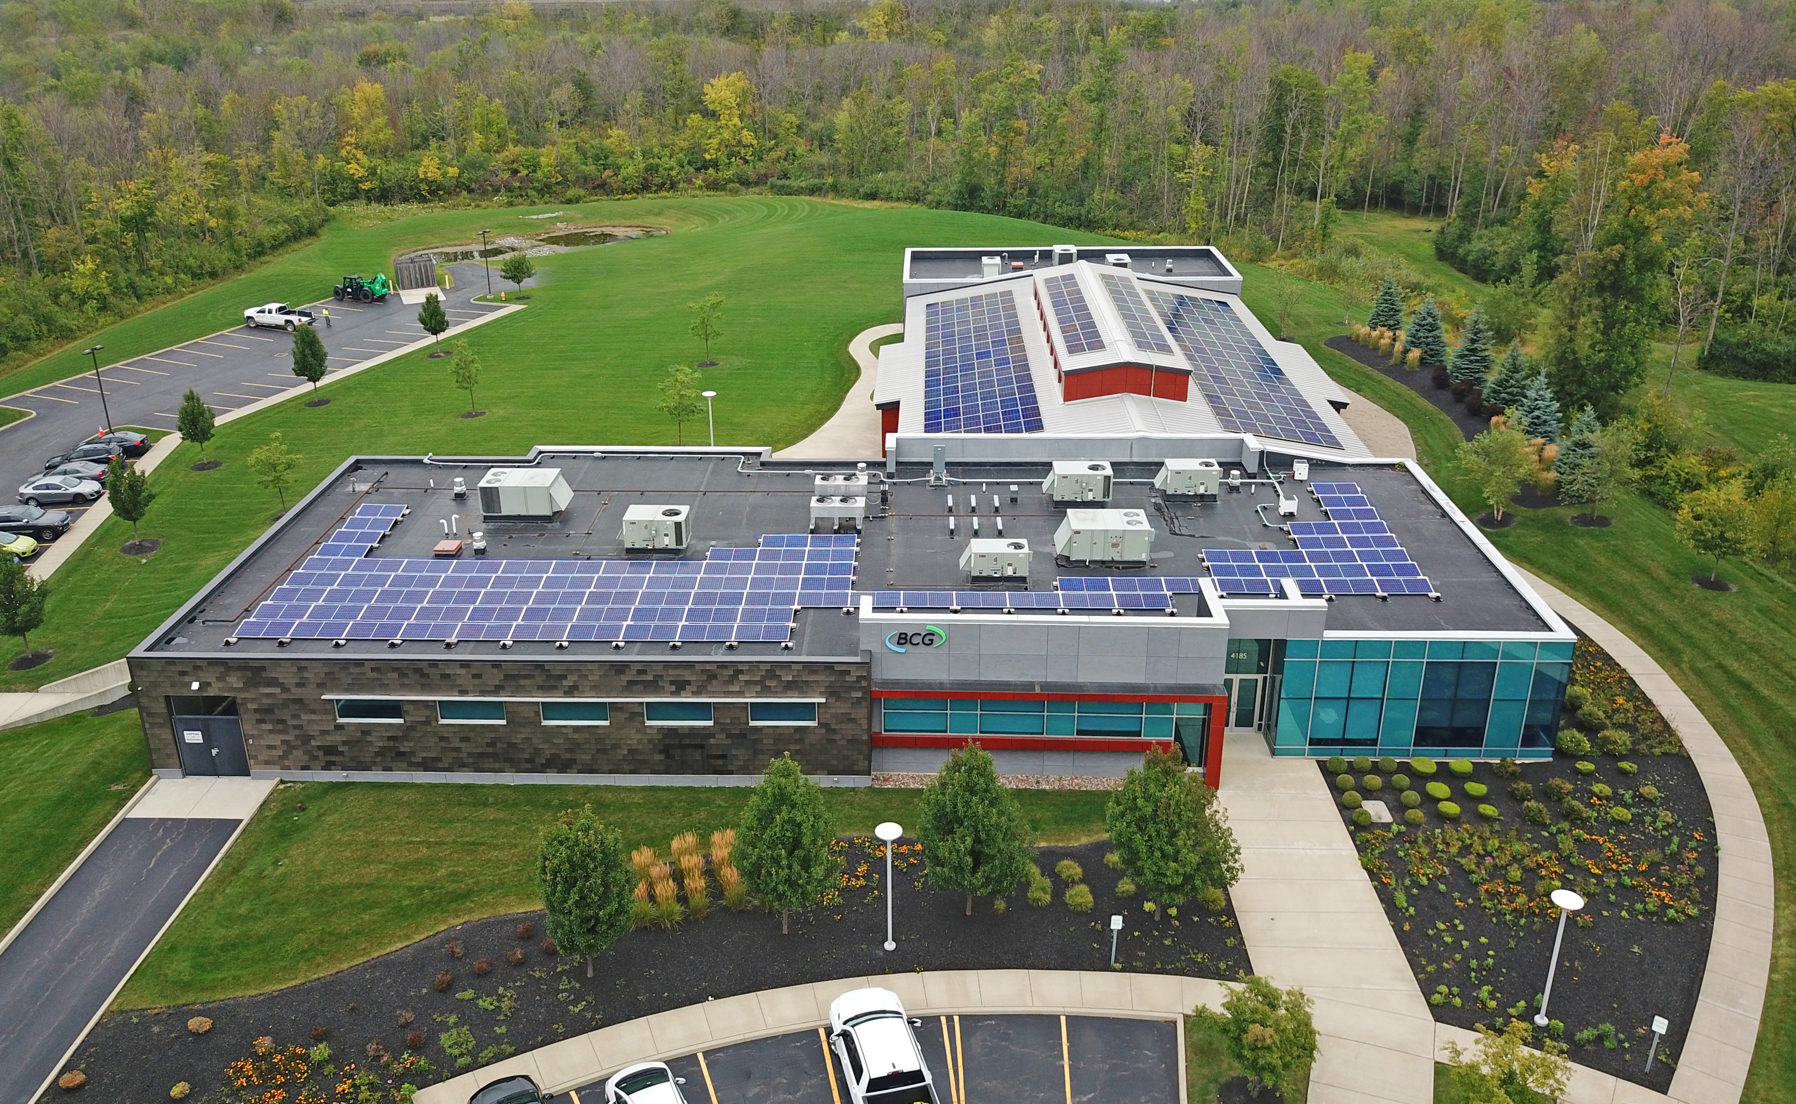
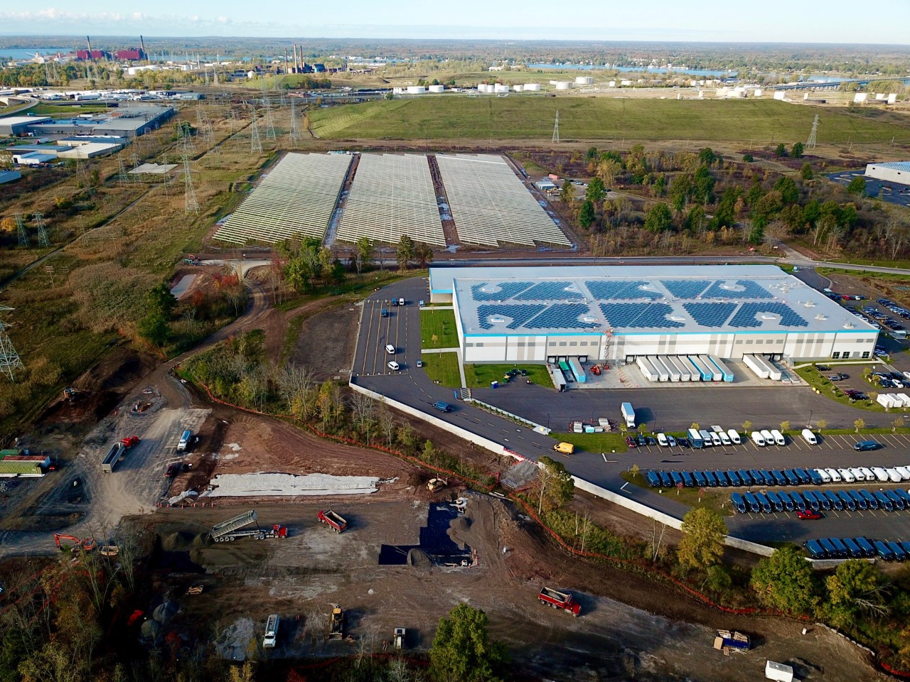
Our Projects
Notes:
Dan Slide

Slide 6
Polling Question #2
Are you familiar with
Federal Investment Tax Credits
associated with Solar Energy Projects?

Slide 7
Financial Returns
How a solar project generates a financial return:
Energy Savings
State Incentives
Federal Investment Tax Credits
Depreciation (if applicable)
Notes:
Dan’s slide

Slide 8
New York State Incentives & Adders
NYS Energy Research and Development Agency (NYSERDA)
NY-Sun Program
Base Cash Incentive
      Commercial Rooftop (50-750kW) $0.25/watt
      Ground Mount (>750kW) $0.18/watt
      Multifamily Affordable Housing $1.00/watt
Adders:
      Brownfield/Landfill Sites $0.15/watt
      Community Solar $0.07/watt
      Inclusive Community Solar TBD
Notes:
Dan Slide

Slide 9
Federal Inflation Reduction Act (IRA)
2022
Investment Tax Credit (ITC)
  Base credit is now 30% (labor requirements)
  10% or 20% bonus credits may apply, increasing the base credit percentage up to a maximum of 70%
  The credit percentage is applied to the total cost of eligible property (capitalized cost)
  Claimed for the tax year placed in service
  Depreciable basis is reduced by 50% of the credit claimed
Production Tax Credit (PTC)
  Percentage base is $.005 or $.026 per kilowatt-hour (kWh)
  The credit percentage is applied per kWh produced each year (dependent on sunlight)
* The ITC provides Better Value than PTC in WNY *
Notes:
Megan Slide

Slide 10
Incentives & Adders – Federal
Base Investment Tax Credit (ITC): 30%
Adders (Stackable):
  Domestic Content 10%
      100% Steel/Iron
      40% Manufactured Products
  Energy Community 10%
      Brownfield Sites – no cleanup necessary
      Proximity to closed coal power plant
      Significant unemployment & prominent fossil fuel industry
  Low Income Community 10-20%
      Limited allocations and competitive solicitation
Notes:
Megan Slide

Slide 11
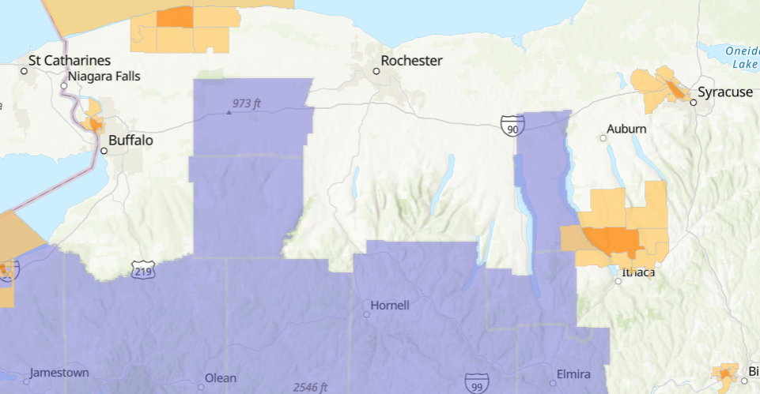
Energy Communities

Slide 12
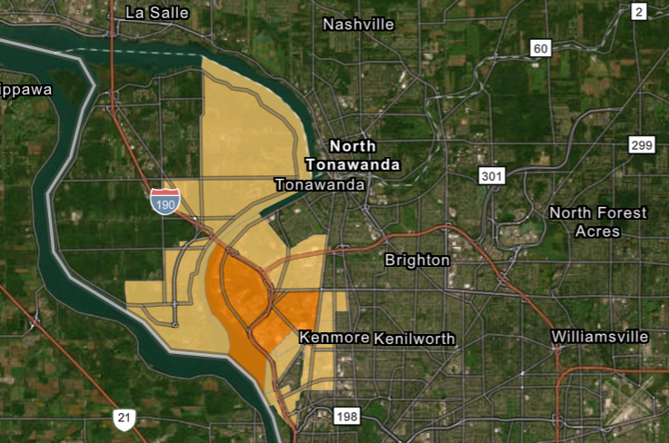
Energy Communities

Slide 13
NYS School Districts in Energy Communities
Addison | Brocton | Elmira City | Hinsdale | Panama | Solvay
Alexander | Buffalo City | Elmira Heights | Hornell City | Pavilion | South Seneca
Alfred-Almond | Byron-Bergen | Falconer | Horseheads | Pembroke | Southern Cayuga
Allegany-Limestone | Campbell-Savona | Fillmore | Jamestown | Perry | Southwestern
Andover | Canaseraga | Forestville | Jasper-Troupsburg | Pine Valley | Trumansburg
Arkport | Canisteo-Greenwood | Franklinville | Johnson City | Portville | Warsaw
Attica | Cassadaga Valley | Fredonia | Lansing | Prattsburgh | Waterloo
Avoca | Cattaraugus-Little Valley | Frewsburg | LeRoy | Randolph | Wayland-Cohocton
Barker | Chautauqua Lake | Friendship | Letchworth | Ripley | Wellsville
Batavia City | Clymer | Genesee Valley | Lydonville | Romulus | West Valley
Bath | Corning City | George Junior Republic | Maine-Endwell | Salamanca City | Westfield
Belfast | Cuba-Rushford | Gowanda | Newfane | Scio | Whitesville
Bemus Point | Dunkirk City | Grand Island | Newfield | Seneca Falls | Wyoming
Bolivar-Richburg | Elba | Groton | Oakfield-Alabama | Sherman | Yorkshire-Pioneer
Bradford | Ellicottville | Hammondsport | Olean City | Silver Creek

Slide 14
Polling Question #3
Is your organization located in an Energy Community?

Slide 15
NEW – Elective (Direct) Pay of ITC
Elective Pay from Treasury is available for tax-exempt and governmental entities
  Tax-exempt organizations
  State and local governments
  Indian tribal governments
To claim elective pay:
  Complete IRS Pre-Registration Process (TBD)
  Part III of Form 3800 to make the election (filed with 990-T)
  Part V of Form 3800 will list multiple facilities/locations for the credit, if applicable
Loans likely needed for construction to bridge timing of receipt of the tax credits from the IRS
Notes:
Megan Slide

Slide 16



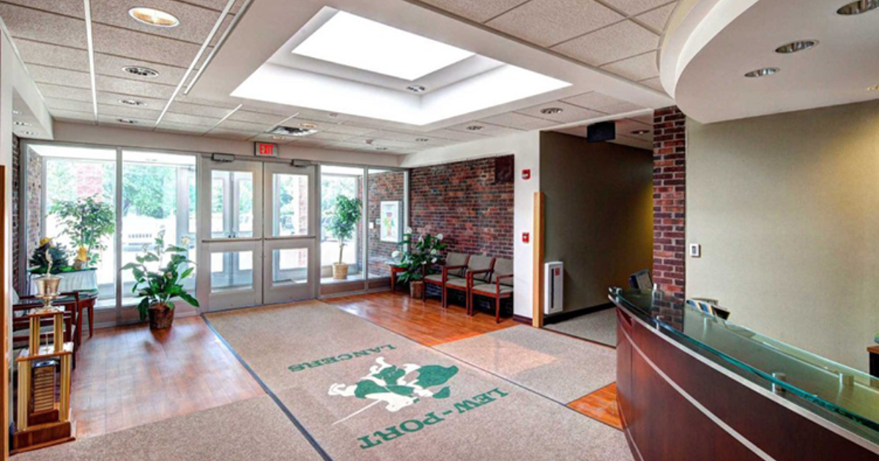
Case Study – Lewiston Porter CSD
Notes:
Dan Slide

Slide 17
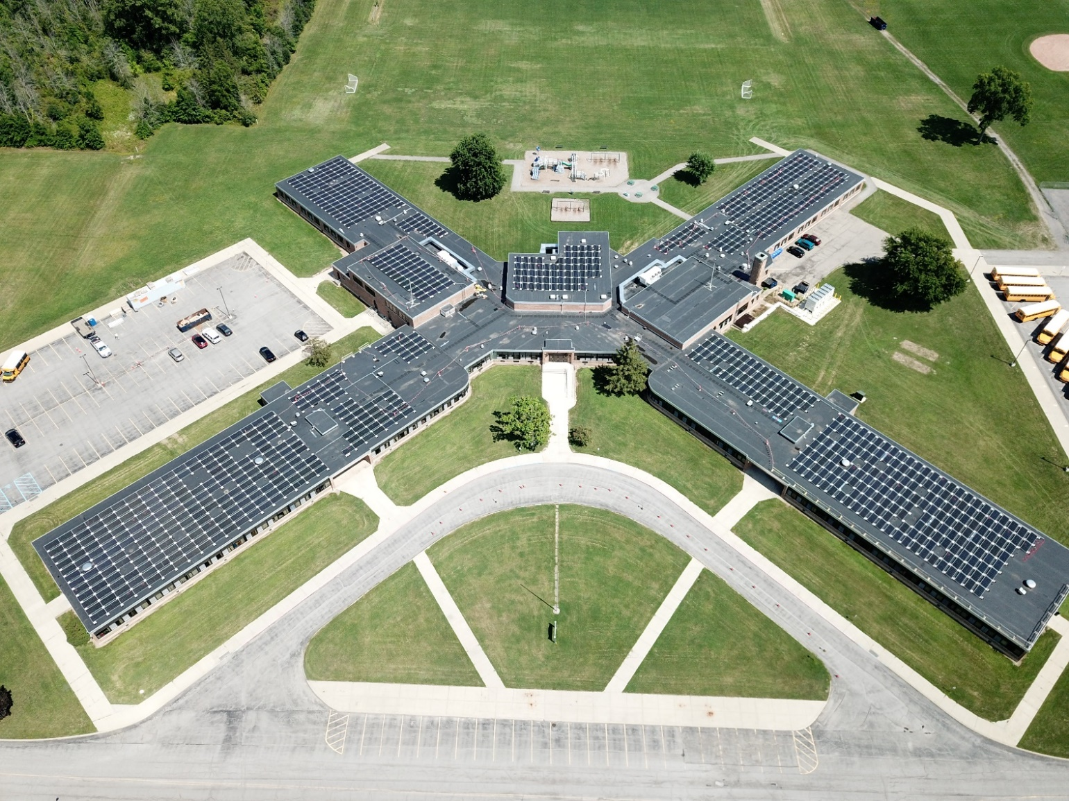
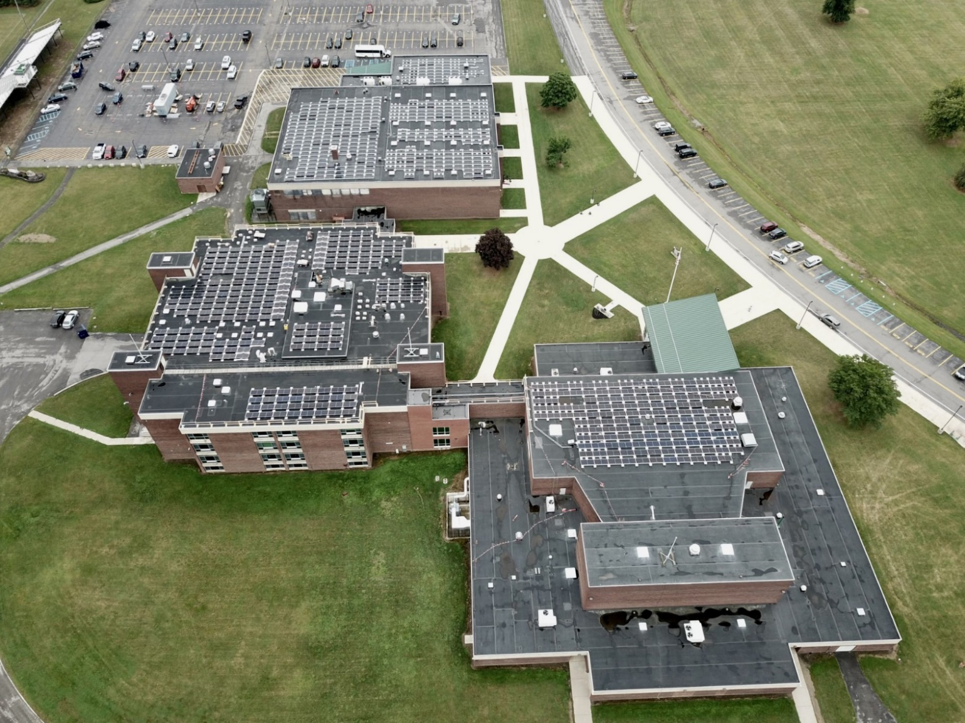
Project Overview
Gross Project Cost: $1.4 Million
Annual Energy Savings: $110,000
Total Number of Panels: 1,750
Lew-Port Elementary School: 600 kW
Lew-Port High School: 400 kW
Notes:
Dan Slide,

Slide 18
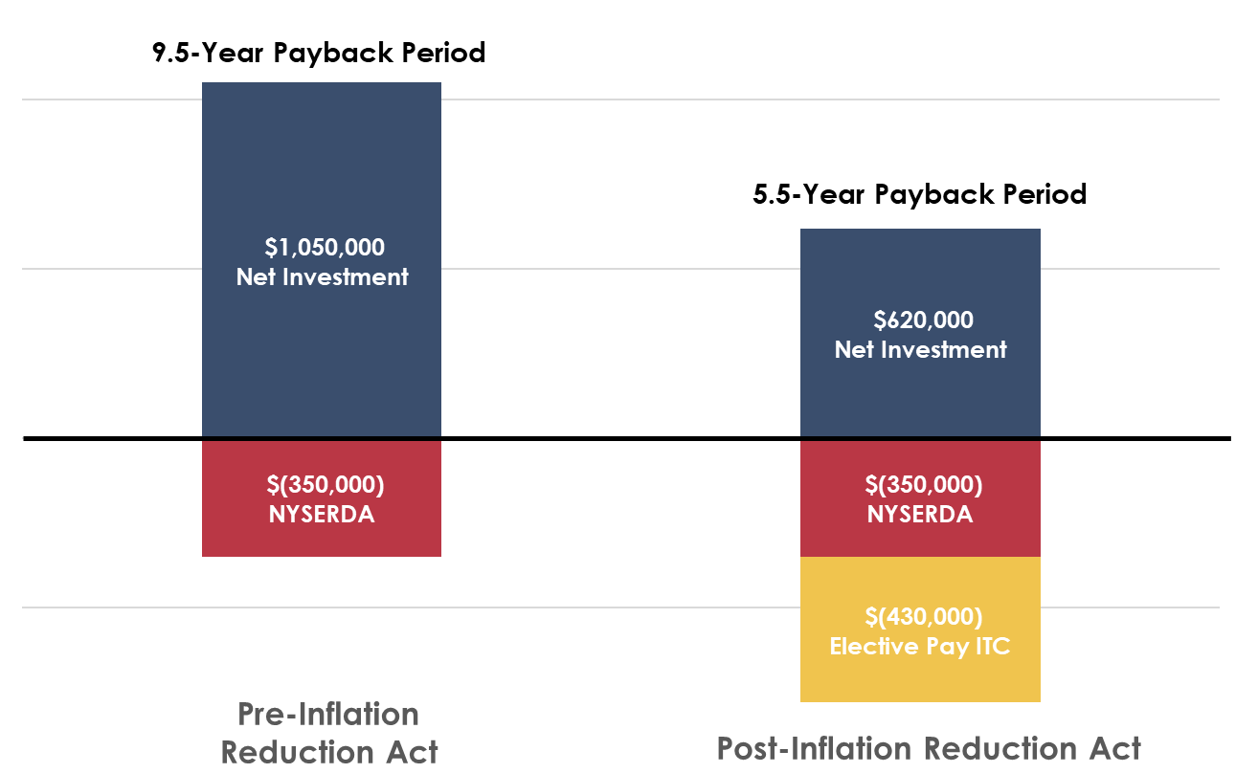
Lewiston-Porter CSD Project Investment
$1.4 Million Project Cost – 1 Megawatt of Total Installed Solar
Notes:
Dan Slide, customer like OG graph

Slide 19
Polling Question #4
Does the new IRA Elective Pay ITC make you more open to exploring solar options for your organization?

Slide 20
Conclusions and Takeaways
ITC vs. PTC: ITC is generally better than PTC for solar projects in Northeast US
Project Ownership Implications: The Elective Pay provision of the Inflation Reduction Act will shift solar project ownership to tax-exempt organizations instead of 3rd parties
Payback Period: Payback periods for solar projects owned by non-profits are 5-6 years
Incentive Adders: Always look for ITC & NYSERDA adder eligibility
K-12 Districts: Solar projects also benefit from NYSED Building Aid
There is no better time to consider solar!
Notes:
Dan Slide: ADD INFO

Slide 21
Polling Question #5
Would you be interested in another webinar to learn more about other Energy Incentives & Tax Credits for your organization?

Slide 22
Appendix: Solar Rules of Thumb
Rooftop Solar
50 – 750 Kilowatt Systems
100 Square Feet per kW
Approximately $2.00/Watt
Ballasted Systems: 5-6 lbs./ft²
Attached Systems: 2-3 lbs./ft²
Ground Mount Solar
Up to 7.5 Megawatt Systems
4 Acres per MW
Approximately $2.00/Watt
Fixed Tilt Systems
Single/Double Axis Trackers
Environmental Due Diligence

