Slide 1


ECONOMICS OF BUFFALO
AFTER COVID
HAVE THINGS CHANGED?
FREDERICK FLOSS
PROFESSOR
DEPARTMENT OF ECONOMICS AND FINANCE

Slide 2
BUFFALO AFTER COVID
In Western New York almost 4,000
persons lost their lives to COVID since 2020.
New York State has lost 64,000 lives, the same as the population of Utica.
COVID continues to take lives each year, but at a declining rate.

Slide 3
In 2020 COVID SHUT DOWN MOST OF THE WORLD
  Buffalo was no exception.
Many businesses closed their doors and laid off workers, others shifted to working from home.
The Federal Government put $5.3 billion into the economy to help families and businesses cope with the pandemic
  Individuals receives $1,400 for those making under $75,000 and $2,800 for married couples making under $150,000. Each child received an additional $1,400.
  Businesses were given funds if the continued to employ their workers.

Slide 4
Economic Update – Polling Question 1
Are you attending this webinar to earn CPE credits?
  Yes
  No

Slide 5
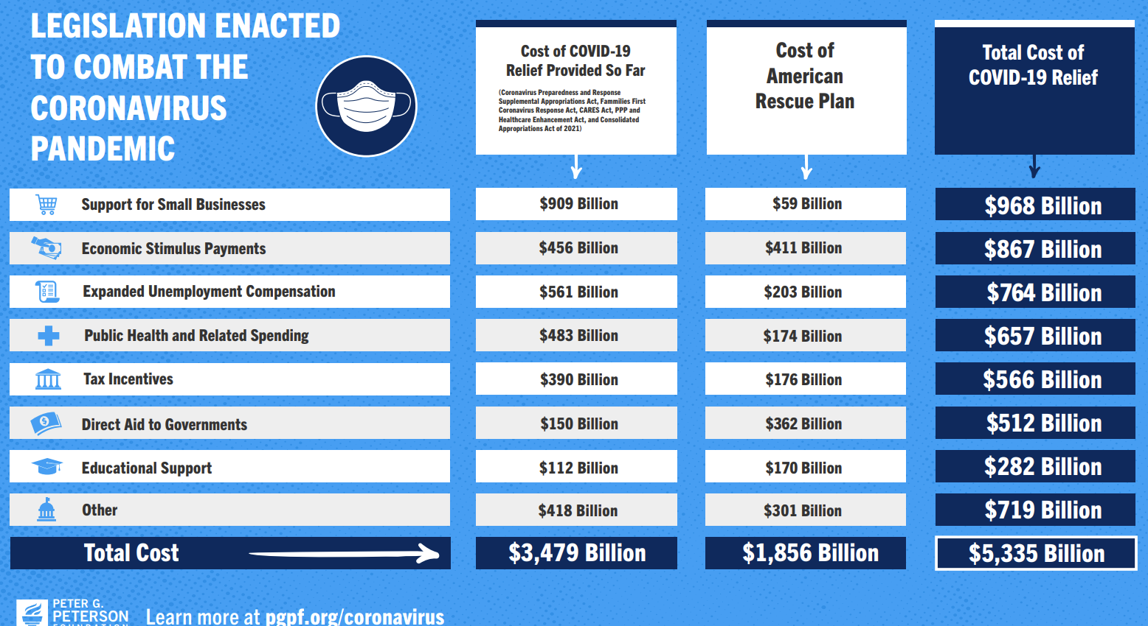

Slide 6
The fear was COVID would put the United States into a Great Depression.
  Between 1929-33 wages dropped by 33.6% in manufacturing
  Unemployment rose to 25% in 1933 and stayed above 10% until 1941 and the start of World War II.
Both the Federal and State Governments worked to make sure they could minimize the harm to the economy.

Slide 7
Unlike the Great Depression wages did not decline during COVID.
In fact, they started to grow at a faster rate.
In 2019 average wages in Buffalo were $50,917 so in 3 years wages increased on average by about $10,000.

Slide 8
Up until 2015 Buffalo’s wages grew at the same rate as inflation.
After that wages started to grow at a faster rate than inflation.
Wages grew even faster with the start of COVID.
Since 2015 workers in Buffalo have seen an increase in their standard of living.

Slide 9
Economic Update – Polling Question 2
Did you increase wages during COVID for your employees?
  Yes
  No

Slide 10
But not all industries are the same.
In food services average wages are only $24,415, while finance on average pays $88,500.
Education is important on how much you will make and COVID has set many students back. Some are dropping out.

Slide 11
In 2001 GDP in the Buffalo MSA was $41.1 billion, by 2019 GDP was $71.4 billion and continued to grow to $80.2 billion.
The largest industry in Buffalo is Finance and grew from 22% of the economy to 26%.
Manufacturing dropped from 17% to 12%. Government has now surpassed manufacturing.

Slide 12
Looking at GDP and Wages COVID does not seem to have had an impact on the economy.
  This would suggest that the federal aid to individuals, businesses and governments had the intended effect of keeping the economy out of recession.
  COVID funding is still being distributed until 2026 by local governments.
  In 2022 Congress passed the Inflation Reduction Act which also added additional funds to the economy.

Slide 13
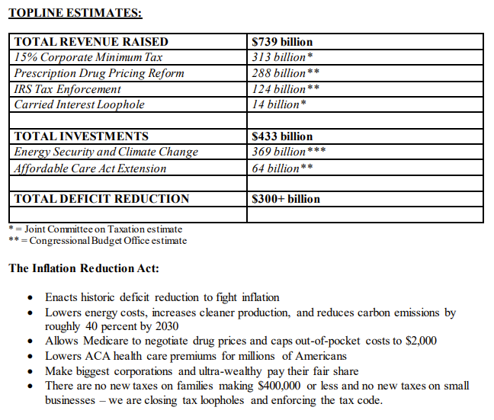
The IRA did a number of things.
Most notably lowers insulin costs to $35 per month.
It also subsidized clean energy projects and infrastructure.
There is also monies for the IRS to increase enforcement.

Slide 14
While Wages and GDP where not impacted by COVID, employment was.
In the first months of the pandemic Buffalo lost 131,100 jobs.
In Oct 2023 the Buffalo MSA was still 14,000 positions short of the high in November 2018.

Slide 15
Economic Update – Polling Question 3
Is your organization still experiencing a staffing shortage?
  Yes
  No

Slide 16
Buffalo to not grow jobs as fast as the rest of the state after the great recession of 2008.
The State dropped by 39% from Dec 2019, in Total Non-Farm employment while Buffalo dropped by 24%.
Both Buffalo and the State are still 2% below their Dec 2019 highs.
Source: BLS CES

Slide 17
The impact of COVID had very different impacts depending on the industry the worker was in.
Manufacturing held up very well while the finance sector took a hit.

Slide 18
So, the economy of WNY has mostly recovered from the COVID pandemic.
  There is still work to do to get employment back to pre-COVID levels.
  But all-in-all Buffalo has weathered the storm.
So, then why do so many think the economy is so bad?
  Is it mortgage rates are high?
  The price of gas (inflation)?
  Politics?
  The stock market?
  Or is it something else?

Slide 19
Economic Update – Polling Question 4
Why do so many think the economy is so bad?
  Is it mortgage rates are high?
  The price of gas (inflation)?
  Politics?
  The stock market?
  Or is it something else?

Slide 20
ECONOMICS OF BUFFALO
AFTER COVID
HAVE THINGS CHANGED?
FREDERICK FLOSS
PROFESSOR
DEPARTMENT OF ECONOMICS AND FINANCE

