Slide 1
GASB Update and a Review of the New Data Collection Form
ELIZABETH S. KRAUSE, CPA
JEREMY J. SMITH, CPA

Slide 2
AGENDA
GASB 100, Accounting Changes and Error Corrections
GASB 101, Compensated Absences
New Implementation Guidance and Upcoming Technical Plan
New Federal Audit Clearinghouse Transition from Census to GSA

Slide 3
  GASB 100, Accounting Changes and Error Corrections

Slide 4
GASB 100, Accounting Changes and Error Corrections
GASB 62 (2010)
Definitions
  Accounting changes
    Changes in accounting principle
      New GAAP or GAAP to GAAP
    Changes in accounting estimate
      Changes to the inputs used for an estimate
      A change in circumstances, new information or more experience
      Change in measurement methodology should be preferable
Notes:
The GASB’s did a study found substantial variation in how it was being interpreted and applied, undermining comparability of the financial statements. Governments and firms had difficulty determining the correct type of accounting change, differentiating changes from corrections, and understanding how the guidance differed for single-year and comparative financial statements. The good news Most of the existing accounting and reporting guidance revisions focused on making them easier to understand and apply rather than altering them substantively.
Accounting Estimates
- Change in the useful life of a depreciable assets
- Change in valuation technique used to measure fair value technique (investments) (new markets, information previously used no longer available, market conditions change) Market approach, cost approach, income approach

Slide 5
GASB 100, Accounting Changes and Error Corrections
Definitions (continued)
  Accounting changes (continued)
    Changes to or within the financial reporting entity
      Component unit added or removed, or changed between blended and discretely presented component units
      Fund added or removed resulting from the movement of continuing operations
      Fund reclassified between major and nonmajor
  Error correction
    Mathematical miscalculations
    Misapplication of accounting principles
    Oversight or misuse of facts
Notes:
Changes to or within the financial reporting entity
- Component units - legally separate organization for which the elected officials of the primary government are financially accountable.
- or Legally separate organizations for which the nature and significance of the relationship with the primary government is such that exclusion would cause the reporting entity’s financial statements to be misleading
- Blended (within FS as part of primary government) vs discretely (separate column government-wide) - (Examples Utility Companies, Housing Authorities, Charter Schools, Not for Profits)
- Blended - is substantively the same as the governing body of the primary government, the component unit provides services entirely, or almost entirely, to the primary government or otherwise exclusively, or almost exclusively, The component unit exclusively, or almost exclusively, benefits the primary government by providing services indirectly.
- Added or removing fund due to movement of continuing operations with primary government. (Example changes sanitation operations as part of General fund to enterprise fund)
- Major vs non-major - 10% of all expense's assets, liabilities, revenues or 5% including Enterprise funds Appendix B of GASB 100 If meet quantitative.
- Any other fund may be reported as a major fund if the government's officials believe that fund is particularly important to financial statement users thresholds
- Previous standard just adding/ removing component units

Slide 6
GASB 100, Accounting Changes and Error Corrections
Change in accounting principle
  Retroactive reporting to earliest period presented (unless impractical) with restatement of beginning net position/fund balance
  Disclosure of reason for change, effects on beginning net position/fund balance, and the reason the change is preferable (unless due to a new pronouncement)
Notes:
Statement 100 requires that the cumulative amount of adjustments and restatements be displayed on the face of the financial statements between the originally reported balances and the adjusted or restated balances for retroactive reporting.
Previously, it was acceptable only to label the beginning balances as restated or adjusted without the actual amounts by which they were changed

Slide 7
GASB 100, Accounting Changes and Error Corrections
Change in accounting estimate
  Prospective reporting from period when change occurs
  Disclosure of reason for change, line items on financial statements affected, and the reason the change is preferable (unless due to a new pronouncement)
Change to or within the entity
  Adjustment to beginning net position/fund balance

Slide 8
GASB 100, Accounting Changes and Error Corrections
Error correction
  Retroactive reporting to earliest period presented (unless impractical) with restatement of beginning net position/fund balance
  Disclosure of reason for change, effects on beginning net position/fund balance for prior period in comparative statements, and effect on prior period’s change in net position/fund balance for single year statements

Slide 9
GASB 100, Accounting Changes and Error Corrections
RSI and SI
  For those periods presented in the basic financial statements, amounts should be similarly adjusted/restated
  For periods earlier than those presented in the basic financial statements, they should NOT be restated (except for error corrections, then all periods presented should be corrected)
Effective for fiscal years beginning after June 15, 2023
Notes:
The prior standards did not address required supplementary information (RSI, such as the pension schedules) or supplementary information (SI, such as the statistical section) because they predated the GASB standards that address RSI and SI.
Error corrections generally should be made for any year affected in RSI and SI, though the GASB provides a practicability exception if that does not prove possible

Slide 10
Polling Question #1
How many reindeer does Santa have?
5
7
9
12
Notes:
9

Slide 11
  GASB 101, Compensated Absences

Slide 12
GASB 101, Compensated Absences
GASB 16 – (1992)
Effective for years beginning after December 15, 2023
Compensated absences defined as leave for which employees may receive one or more:
  Cash payments when the leave is used for time off
  Other cash payments, such as for unused leave upon termination of employment
  Noncash settlements, such as conversion to defined benefit postemployment benefits
  Includes vacation, sick time, PTO, holidays, parental leave, bereavement leave, and certain sabbatical leave
Notes:
The current standard, GASB 16, provides guidance specific to the type of leave and has become outdated (Only applied to Sick, vacation and sabbatical) . Currently employers provide leave types that weren’t contemplated when GASB 16 was originally issued, and there are many differences in the way absences are handled by individual governments. The goal of the standard is to create a more consistent model for accounting for compensated absences that can be applied to all types of compensated absence arrangement.
Effective for years beginning after December 15, 2023 (early Adoption permitted)
Old standard – Vacation, Sick and Sabbatical Leave

Slide 13
GASB 101, Compensated Absences
Other leave (family, military, and jury duty)
  Not recognized as a liability until the leave actually commences or is used
Unlimited PTO and Holiday – Not accrued
Sabbatical leave
  Sabbatical leave during which an employee is NOT required to perform any significant duties for the government (unrestricted sabbatical leave) IS a compensated absence. Sabbatical leave during which an employee is required to perform duties of a different nature for the government (for example, research instead of teaching) is NOT a compensated absence
Notes:
Leave that is dependent on the occurrence of an event – Family, Military Leave or Jury Duty- should not recognize a liability for unused leave time unless the leave had begun as of the end of the reporting period. For example, if parental leave is 3 months, and qualifying leave started June 1, June 30th is fiscal year end, you would record for remainder 2 months. (Standard excluded sabbatical and sick leave from this treatment)
Unlimited PTO and Holiday leave that is taken on a specific date as opposed to floating holidays (that employees use at their discretion )should not be recognized as a liability until the leave is used. Floating holidays accrue.

Slide 14
GASB 101, Compensated Absences
Leave that has not been used should be recognized as a liability if meets all three criteria below:
  The leave is attributable to services already rendered
  The leave accumulates
  The leave is more likely than not (more than 50%) to be used for time off or otherwise paid in cash or settled through noncash means
Governments – Make an assessment to support %
  Review employment policies, historical information about leave usage, payments upon termination, and forfeitures of leave
Notes:
The threshold for future payment/ liability under GASB 101 decreased from “probable” (likely) (80% not defined) – but general rule amongst auditors to “more likely than not” (likelihood of 50% or higher). The liability for sick leave increases under GASB 101.
The main difference between current guidance GASB 16 and GASB 101 is the pivot from a rules-based approach to a conceptual framework approach. For example, under GASB 16, governments have two options (Vesting and termination Payment Method) in accounting for sick leave, both of which only require the government to accrue for sick time that will be paid in the form of a termination payment (but not for the future use of sick time already earned). Under GASB 101, sick leave will be calculated in the same manner as any other type of compensated absence. Governments are required to accrue for time that has accumulated and is likely to be used, even if the employee will never be eligible for a termination payment related to unused time. This wasn’t a requirement under GASB 16.
Similar to current guidance, governments should use rate of pay as of balance sheet date when calculating the liability. Does not require calculation of future rate of pay. Also exception if arrangement for a different rate of pay at time of payment (Example $50 per day unused)

Slide 15
GASB 101, Compensated Absences

Slide 16
GASB 101, Compensated Absences
Leave that is more likely than not to be settled through conversion to defined benefit postemployment benefits should not be recognized as a liability for comp absences
Compensated absences to be paid via distribution to an individual account or for a specified purpose, such as towards healthcare premiums, and meeting all other recognition criteria, should be included in the calculated liability for compensated absences
Notes:
Leave settled through conversion to defined benefit or OPEB should NOT be included in as comp absences, (It is being recognized in OPEB and Defined Benefit Pension liability) Don’t double book.
Similar Treatment – IRA or 403B – Retiree HI.

Slide 17
GASB 101, Compensated Absences
Compensated absences should be recognized as liabilities on the government-wide statements for leave that has not been used and leave that has been used but not yet paid or settled
  Should include applicable salary-related payments, such as social security and Medicare, but only for portion of leave for which such payment would be required (e.g. time off)
  TRS/ERS/PFRS
    Governmental Funds – Recognize current portion
        This liability will include payments for unused compensated absences or leave used not paid for those employees that have obligated themselves to separate from service with the government by fiscal year end and expected to be paid with current resources
Notes:
General rule - Recognize liability for leave and associated salary-related payments when leave is earned (economic resources measurement focus/accrual basis of accounting)
Salary-related payments – Employer share of payroll taxes; employer contributions to a defined contribution PEB plan, employer - defined contribution plan etc.
Government Funds - current financial resources measurement focus and the modified accrual basis of accounting and expenditures are recognized in the period in which the fund liability is incurred. Government-wide - Economic resources measurement focus and the accrual basis of accounting. Thus, revenues are recognized in the accounting period in which they are earned and become measurable without regard to availability, and expenses are recognized in the period incurred, if measurable.
Current Portion – What year budgeted for?

Slide 18
GASB 101, Compensated Absences
TRS/ERS
  ERS – Per NYSLRS – Payments excluded from retirement contribution and monthly reporting consist of unused personal, sick, and vacation for Tiers 2-6
  TRS – per NYSTRS - Payments for unused leave accruals, such as for vacation or personal days, are considered termination payments that must be reported to NYSTRS, regardless of when during a member's career the payments are made
    Employers will only be billed on these payments for any Tier 1 member with a date of membership prior to June 17, 1971

Slide 19
Polling Question #2
What number does Josh Allen wear?
5
7
12
17
Notes:
17

Slide 20
  Implementation Guidance and Upcoming Technical Plan

Slide 21
Implementation Guide No. 2023-1
Lease and SBITA topics (Q&A’s 4.1-4.9; 5.1)
  Effective for fiscal years beginning after June 15, 2023 (e.g., fiscal years beginning July 1, 2023, January 1, 2024)
Accounting changes and error correction topics (Q&A 4.10)
  Implement simultaneously with GASB 100, accounting changes made in fiscal years beginning after June 15, 2023, and reporting period thereafter
  If GASB 100 implemented before IG Update 2023 issued, effective for fiscal years beginning after June 15, 2023, and reporting period thereafter

Slide 22
Disclosure and Classification of Certain Capital Assets
No changes proposed to measurement and display of capital assets in financial statements
Proposes to require separate disclosure of intangible capital assets
Proposes to define and require separate disclosure of capital assets held for sale
Proposed to become effective for fiscal years beginning after June 15, 2025, and all reporting periods thereafter
  Retroactive application to first period presented, if practicable

Slide 23
Financial Reporting Model Improvements
Proposed improvements to the financial reporting model – statements 34, 35, 37, 41, and 46, and interpretation 6
Review of standards for improvement
Considered for issuance in early to mid 2024

Slide 24
Revenue and Expense Recognition
Proposed comprehensive model for recognition of revenues and expenses
Guidance for exchange and nonexchange transactions
Issuance of an exposure draft considered in early 2025

Slide 25
Going Concern Uncertainties and Severe Financial Stress
Review of existing standards relating to going concern and address issues related to disclosures regarding such
Going concern may not be concern for governments, which hardly go out of business, but users need information regarding governments’ severe financial stress
Preliminary views expected in late 2024; exposure draft considered for mid 2026

Slide 26
Infrastructure Assets
Address issues related to the accounting and financial reporting of infrastructure assets
Based on research, all types of stakeholders stated the information about the condition and maintenance costs of infrastructure needs to be improved
Preliminary views expected in mid 2024; exposure draft considered for early 2026

Slide 27
Certain Risk Disclosures
Proposed standards to identify and disclose risks faced by governments
Ongoing financial and economic issues prompted stakeholders to ask the GASB to consider what governments should report about some risks they face
Exposure draft issued mid 2022; final statement considered for issuance in December 2023

Slide 28
Subsequent Events
Evaluating existing guidance related to subsequent events and the usefulness of information reported by governments
Inconsistent application of existing guidance
Added to technical agenda in mid 2023

Slide 29
Polling Question #3
How many championships have the Buffalo Bandits won?
0
3
5
7
Notes:
5

Slide 30
  New Federal Audit Clearinghouse
  Transition from Census to GSA

Slide 31

Federal Audit Clearinghouse (FAC)
Triggered when an entity spends $750,000 or more in federal grant funds in a given year
A system that the federal grantees and grantors must use to submit and review audit data and resolve audit findings
Single point of entry for auditors and grant recipients

Slide 32
FAC Transition
In January 2022, OMB directed that GSA become the Designated Agency for FAC to address long-standing technical debt, relying heavily on American Rescue Plan (ARP) funds
On October 2, 2023, GSA launched the FAC Minimum Viable Product (MVP) on a modernized back-end system

Slide 33
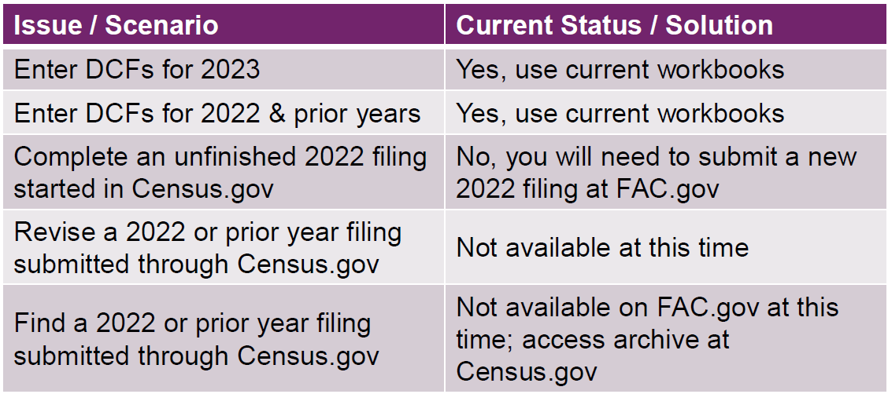
FAC Transition

Slide 34
Extensions Provided
For fiscal-year ends between January 1, 2023 and September 30, 2023, OMB waived the 30-day requirement in 2 CFR 200.512(1)
OMB will consider these audits on time if they are submitted within nine months of their fiscal period end date

Slide 35
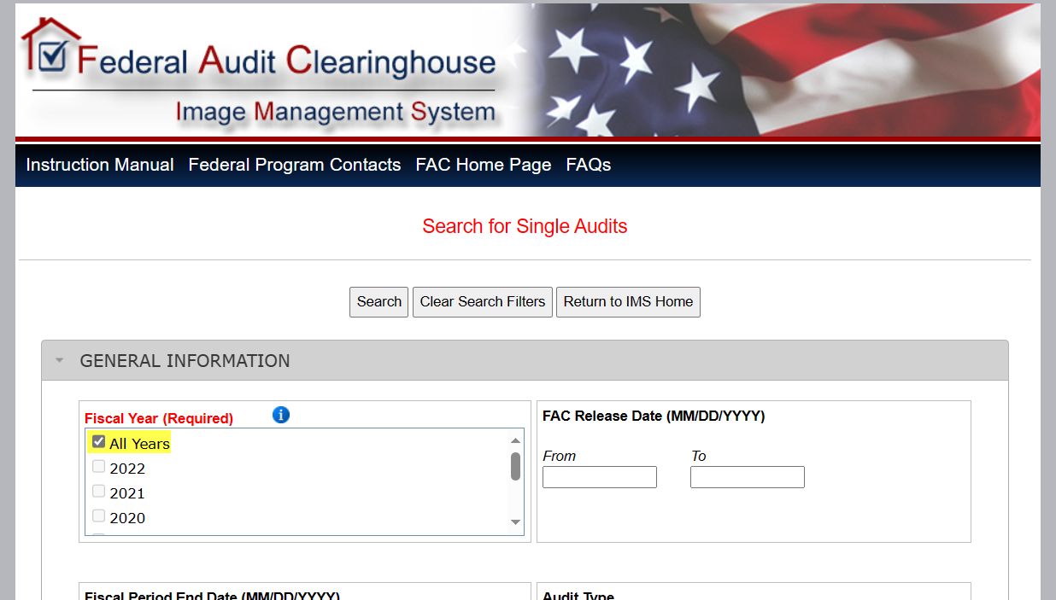
Historical Submissions to Census
Historical FAC records for FYs 2016-2022 can currently be found on: https://facdissem.census.gov/SearchA133.aspx

Slide 36

U.S. General Services Administration (GSA)
  Independent agency of the U.S. Government
  Helps manage and support federal agencies in their mission
  Digital government
  https://www.gsa.gov/

Slide 37
Unique Entity Identifier (UEI)
12-character alphanumeric ID assigned to each entity by SAM.gov
DUNS number has been removed
Find your existing UEI or register for a UEI at SAM.gov

Slide 38
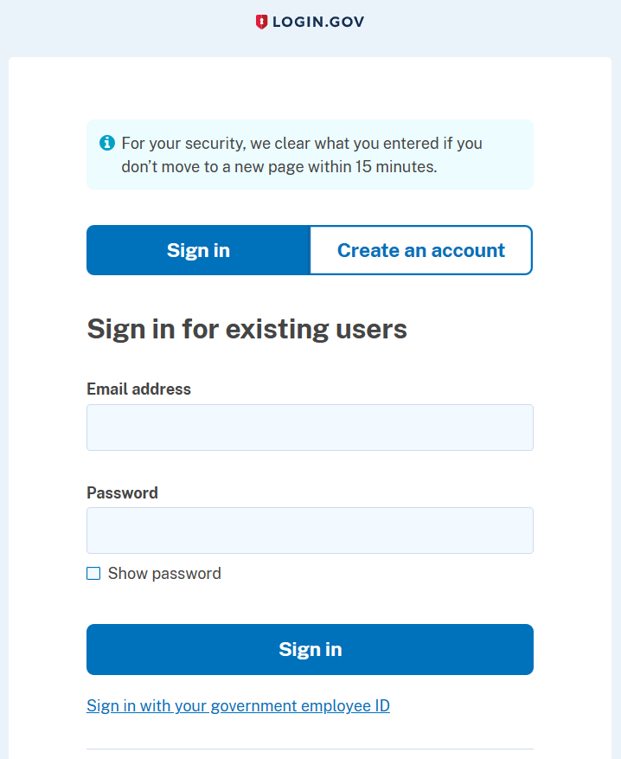
LOGIN.GOV
In order to log in to SAM.gov and FAC.gov everyone (auditees and auditors) involved in the single audit process must have an account with LOGIN.gov

Slide 39
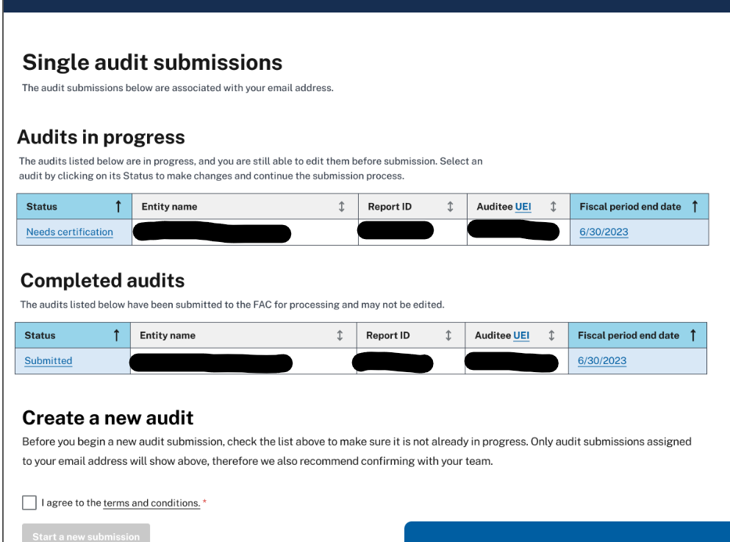
Single Audit Submissions
Once logged in, you can create a new audit and see the status of audits currently in progress. You'll be able to view the status of all audits associated with your email address

Slide 40
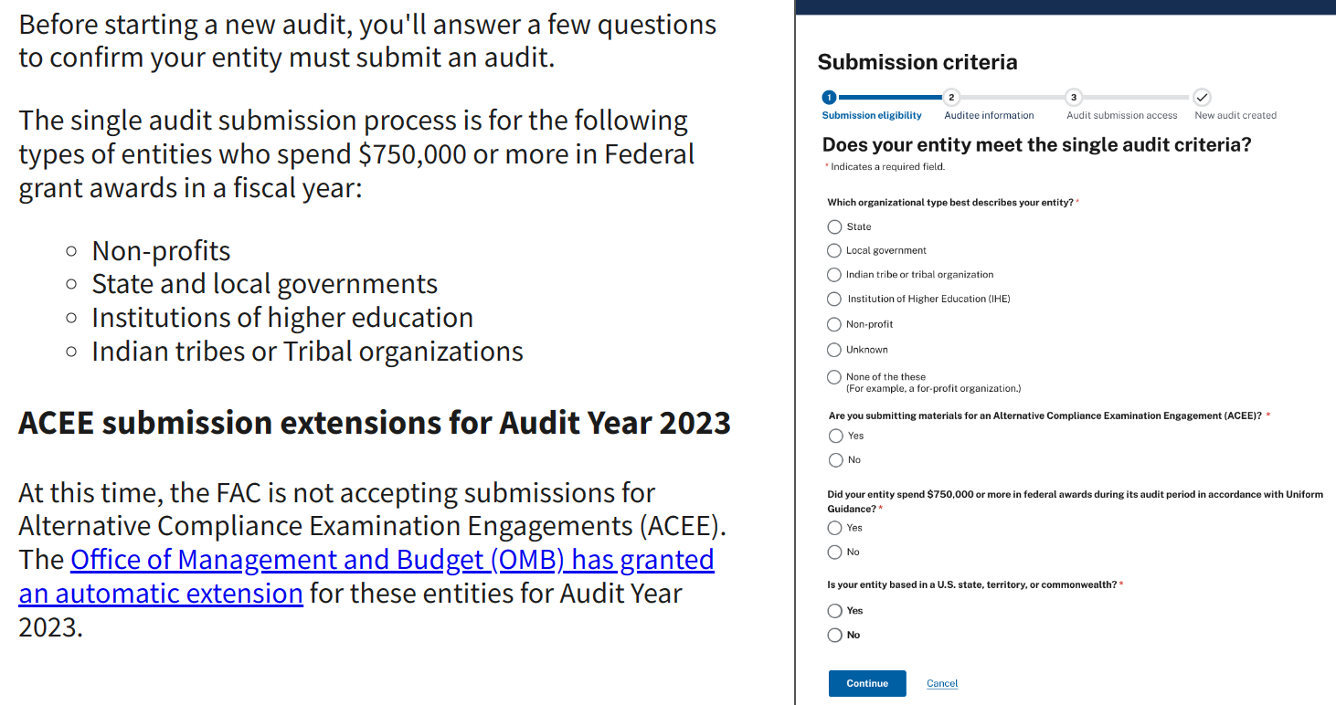
Submission Eligibility

Slide 41
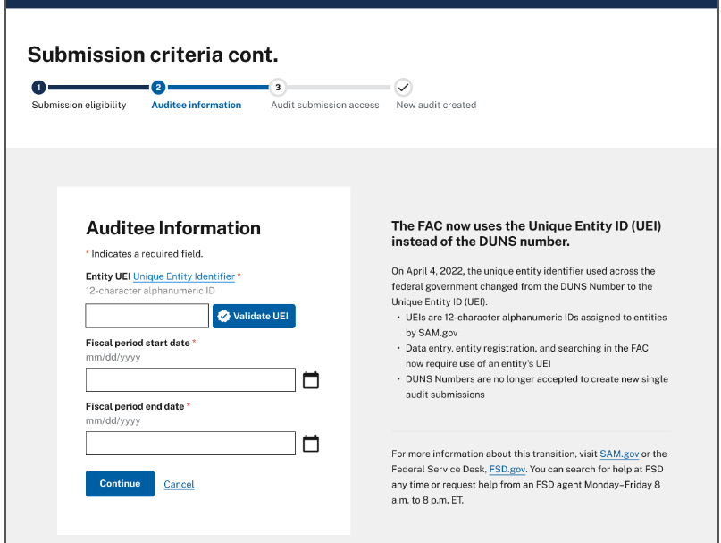
Auditee Information

Slide 42
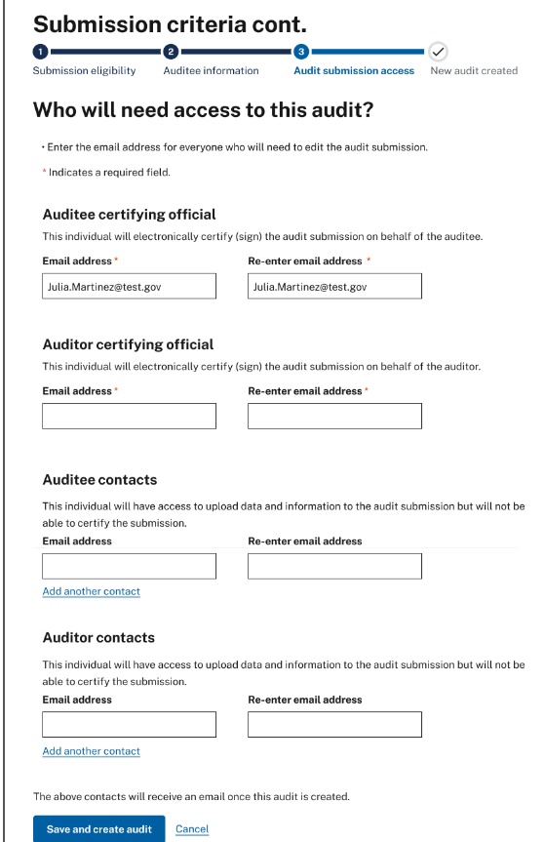
Audit Access
Auditor
Auditee
Certifying officials
Anyone who will need to enter data or edit the single audit
Be sure to gather the names and email addresses of all individuals who will require access to the audit before proceeding with this step

Slide 43
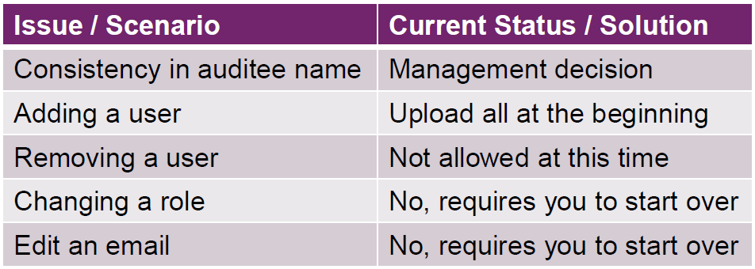
Audit Access

Slide 44
Key Process Changes
General and audit information
  Form style entry
Audit report and F/S
  PDF upload
Federal awards, findings, and corrective action plan
  Workbooks

Slide 45
General & Audit Information
Audit type
Audit period
Fiscal period
Auditee and auditor information
Financial statements and federal programs

Slide 46
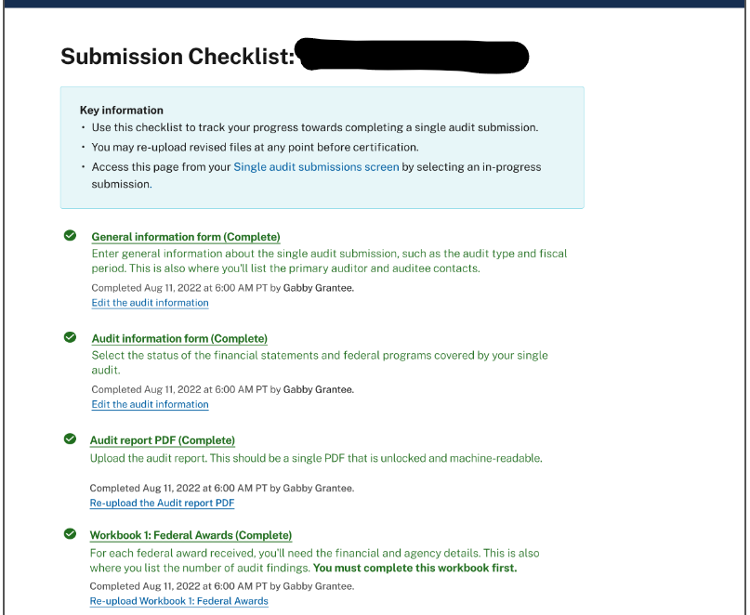
Submission Checklist

Slide 47
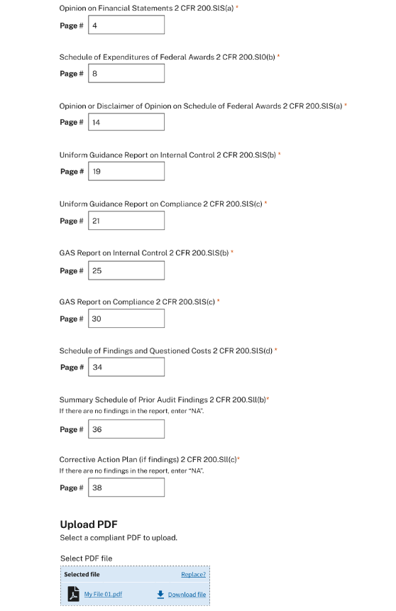
Upload Single Audit
Merge all components of the audit report package into single PDF file
Verify the PDF meets the formatting requirements
Remove all Personally Identifiable information (PII)
Enter page numbers for each required component

Slide 48
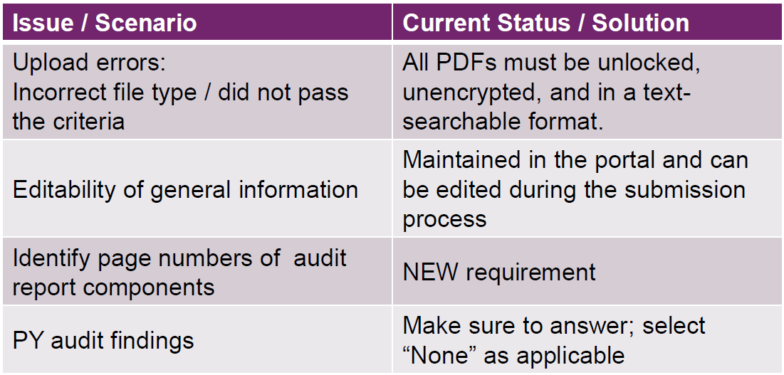
Upload Single Audit

Slide 49
Upload Audit Workbooks
Workbook 1: Federal awards
Workbook 2: Notes to SEFA
Workbook 3: Federal award findings
Workbook 4: Federal award findings text
Workbook 5: Corrective action plan
Workbook 6: Additional UEIs (optional)
Workbook 7: Secondary auditors (optional)
Workbook 8: Additional EINs (optional)

Slide 50
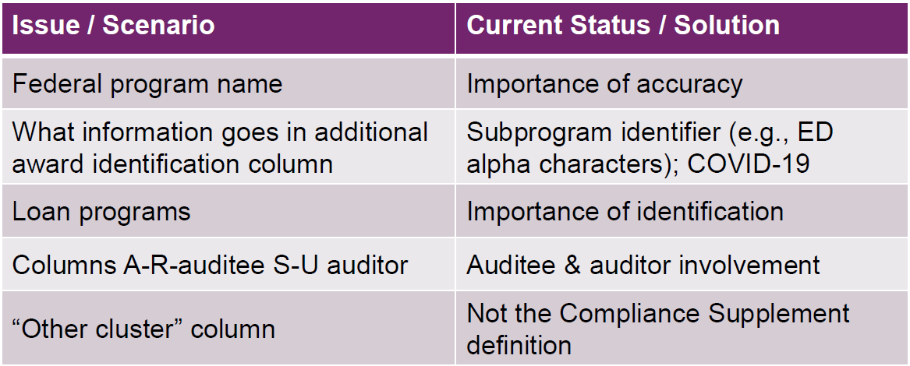
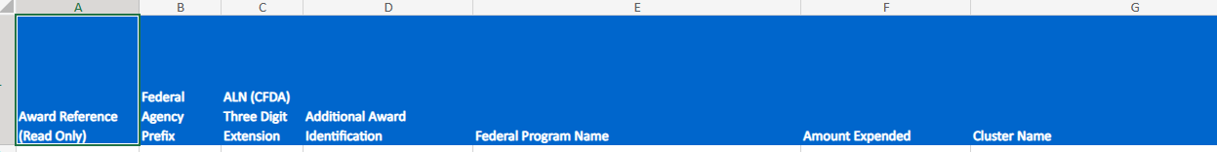
Workbooks

Slide 51
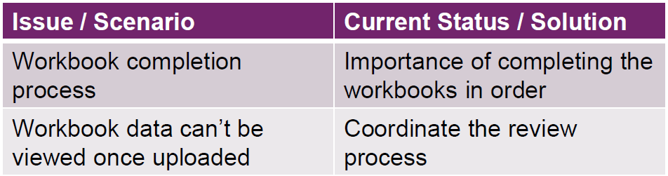
Workbooks

Slide 52
Finalizing
Tribal data release
Pre-certification validation
Lock for certification
Audit certification and confirm submission

Slide 53
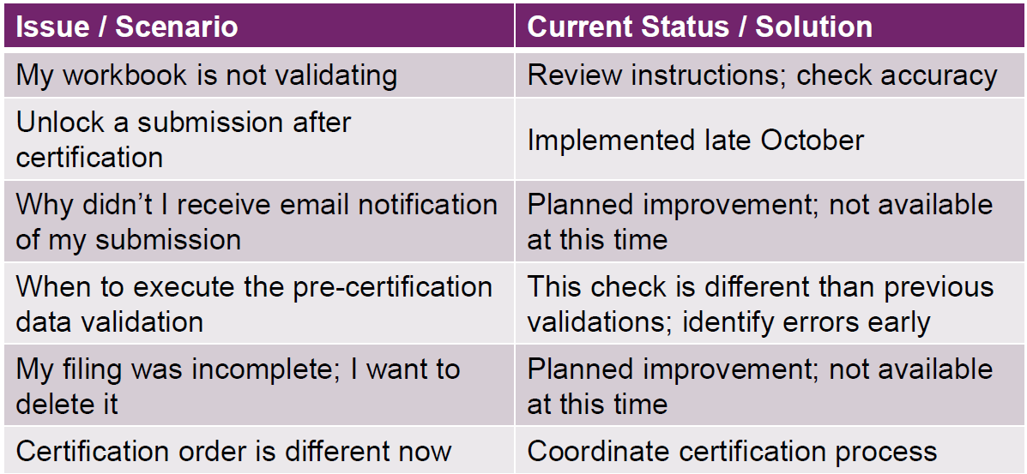
Finalizing

Slide 54
More Pointers
Automatic emails are not generated after each step of certification
Make sure the best UEI is entered as the main UEI
Verify accuracy and matching between the SEFA and the audit findings to avoid validation errors
Row height can’t be expanded – click on cells to review
User login information can not be edited at this time

Slide 55
Polling Question #4
What year was the Buffalo Sabres founded?
1950
1960
1970
1980
Notes:
1970

