Slide 1

Cybersecurity Threats: How to Avoid Being the Next Victim
Lumsden & McCormick Exempt Organizations Conference 2023
December 1, 2023
Mike Olfano, CEO | PCA Technology Group, Inc. | molfano@pcatg.com | 716.632.5881 x314

Slide 2

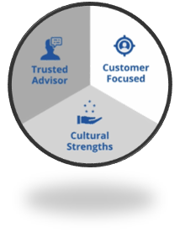




about PCA Technology Group
We have over 34 years of experience
We carefully listen to customer needs
We build roadmaps that make sense
Guiding companies to succeed with Technology.
Managed & Outsourced IT
Cybersecurity
Cloud Computing
Business Phone Systems
Software Development
Resources: pcatg.com/

Slide 3
Agenda
Cybersecurity Statistics
Social Engineering Methods
Phishing, Spear Phishing, Whaling
Vishing & Smishing
Websites / Social Media
Recommended Cybersecurity Solutions

Slide 4
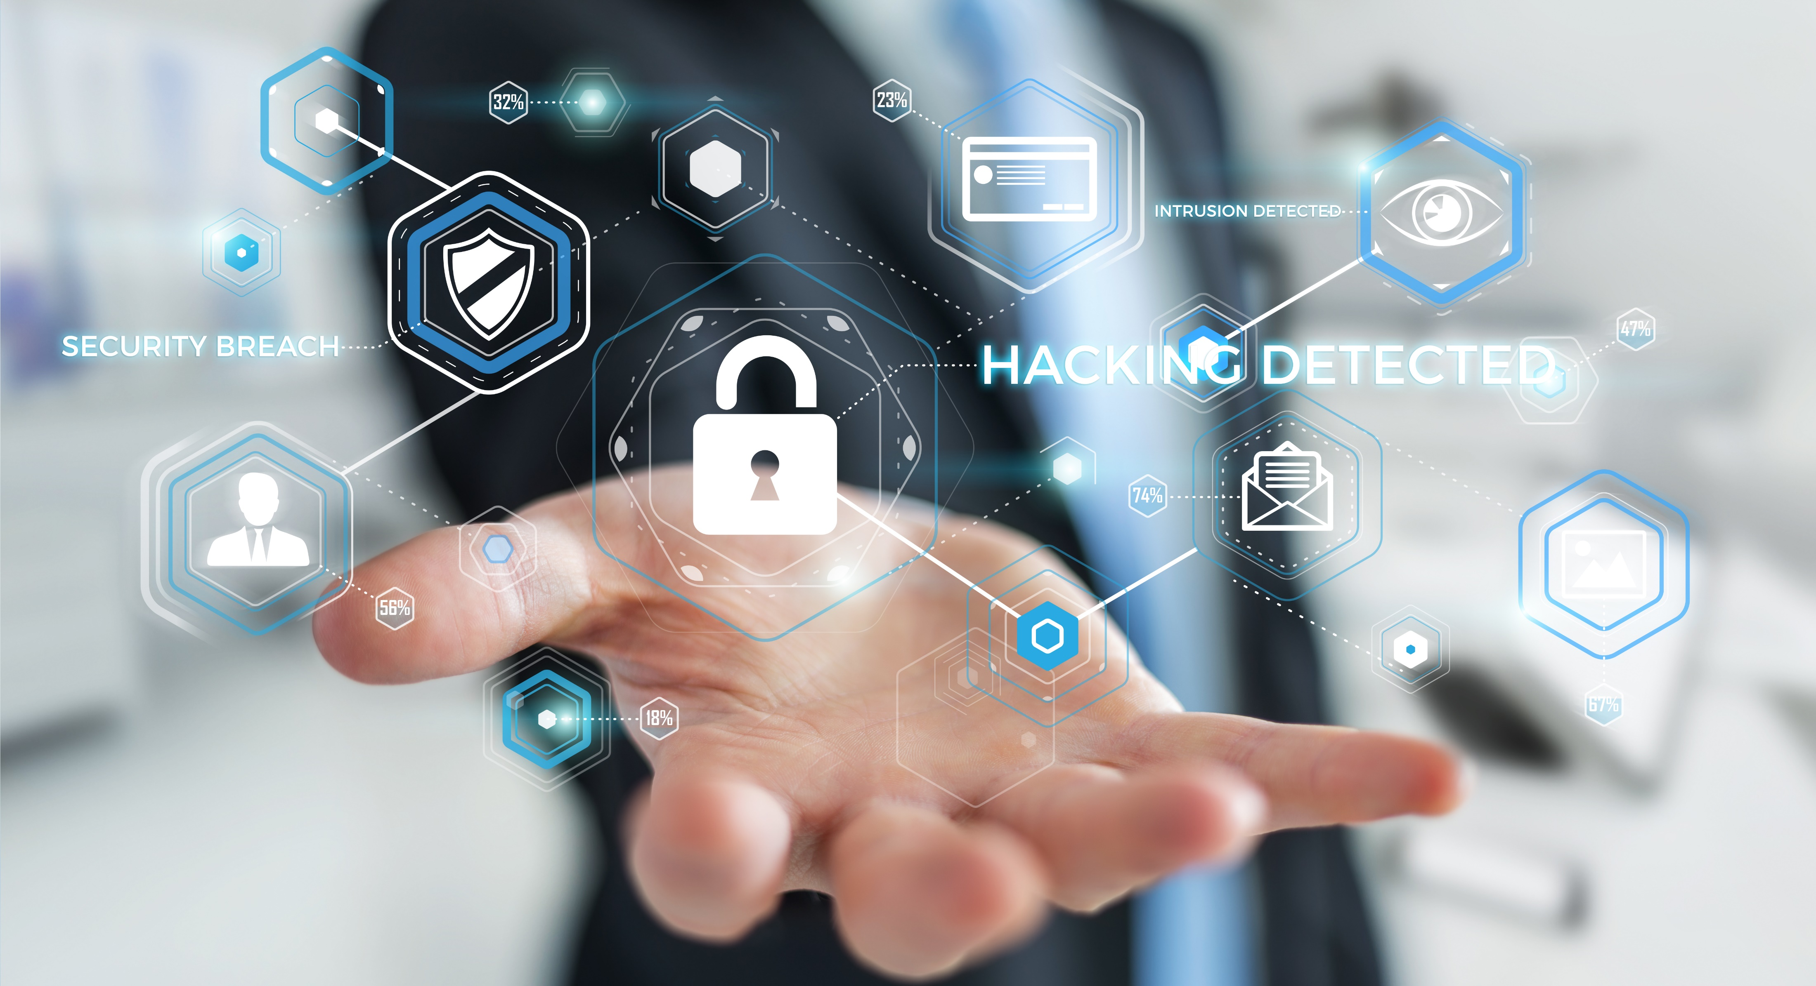
Cybersecurity Statistics

Slide 5

Cybersecurity Statistic #1
Cybercrime will cost the world an estimated $8 trillion by the end of 2023
This will be more costly than all the natural disasters in the world combined
This will be more profitable than the global trade of all the major illegal drugs combined

Slide 6
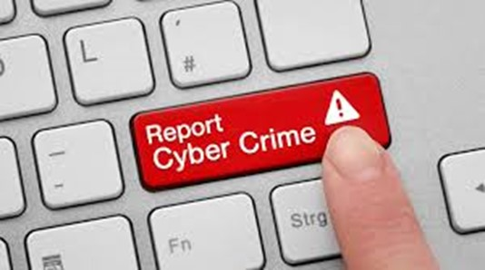
Cybersecurity Statistic #2
Only 10% of cybercrimes are reported in the United States each year
Being hacked is often embarrassing and could cause reputational harm
There is a perception, which is often an unfortunate reality for smaller organizations, that law enforcement will not be able to help

Slide 7
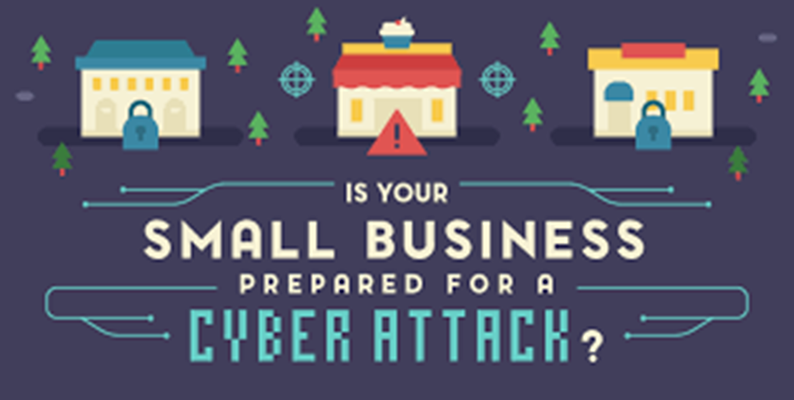
Cybersecurity Statistic #3
Half of all cyberattacks are targeted at small organizations
Leaders of small organizations often do not pay attention to cybersecurity, thinking that they’re not even worth being attacked, and this is what makes them a perfect target
On average, cyberattacks now cost small organizations $200,000

Slide 8

Cybersecurity Statistic #4
92% of cyberattacks start with a phishing email
The top five reasons that people are duped by phishing emails:
Curiosity
Fear
Urgency
Reward / Recognition
Social

Slide 9
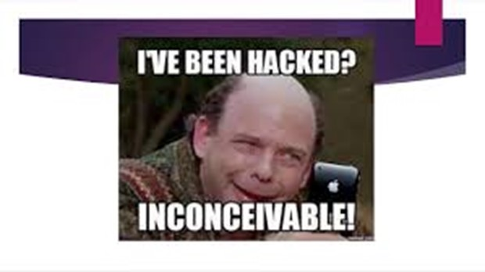
Cybersecurity Statistic #5
In 2022, 34% of all attacks were launched as Business Email Compromise (BEC) attacks and that 80% of organizations that fell victim to these attacks didn’t have multi-factor authentication (MFA) in place.
This means that criminals have gained access to user’s email accounts and can monitor email at will as well as send emails directly from a user’s email account.

Slide 10
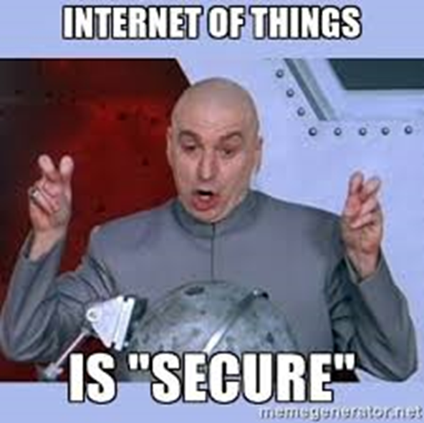
Cybersecurity Statistic #6
On average, it takes about 5 minutes to attack an IoT (Internet of Things) device
Examples of popular IoT devices:
Watches
Security systems
Doorbells
Amazon Echo / Dot
Thermostats
Lighting systems
TVs and remote controls
Smart plugs
Door locks
Smoke alarms

Slide 11
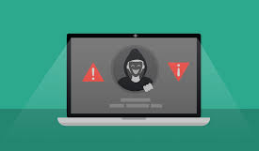
Cybersecurity Statistic #7
50K websites are hacked daily and 97% of WordPress site hacks are a result of plugin exploits.
Websites don’t update themselves and they are often overlooked because they are hosted in the cloud. Do you know if your website is secure?

Slide 12
Polling Question #1
Have you ever attended a cybersecurity user awareness seminar/webinar?
Yes
No

Slide 13


Slide 14
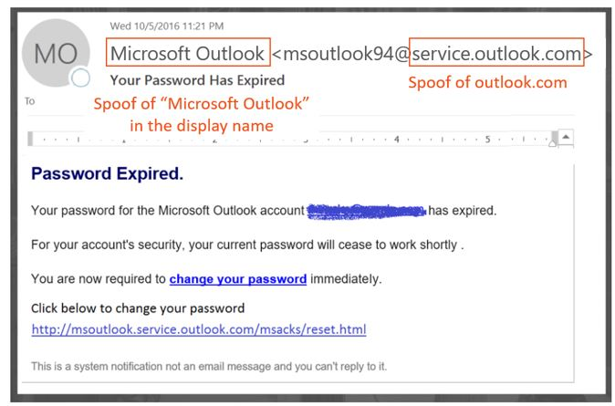
Phishing Emails
Phishing: A “trustworthy entity” asks (typically via email) for your sensitive information such as SSN, credit card numbers, login or password information, etc.

Slide 15
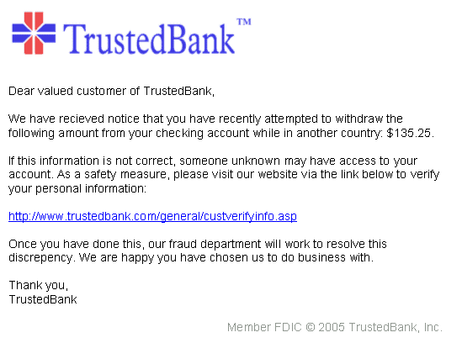
Pharming – Fake Webpages
Never utilize website links within emails for financial and many other websites. If you normally access the site, open a browser and go to it directly.

Slide 16
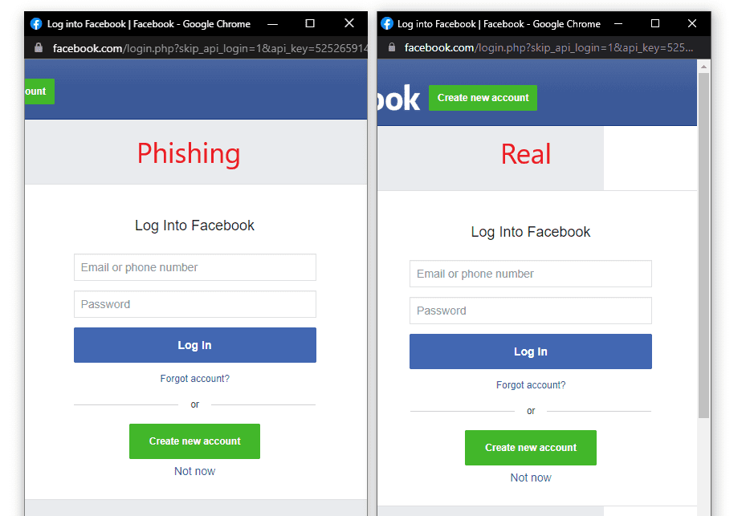

Slide 17
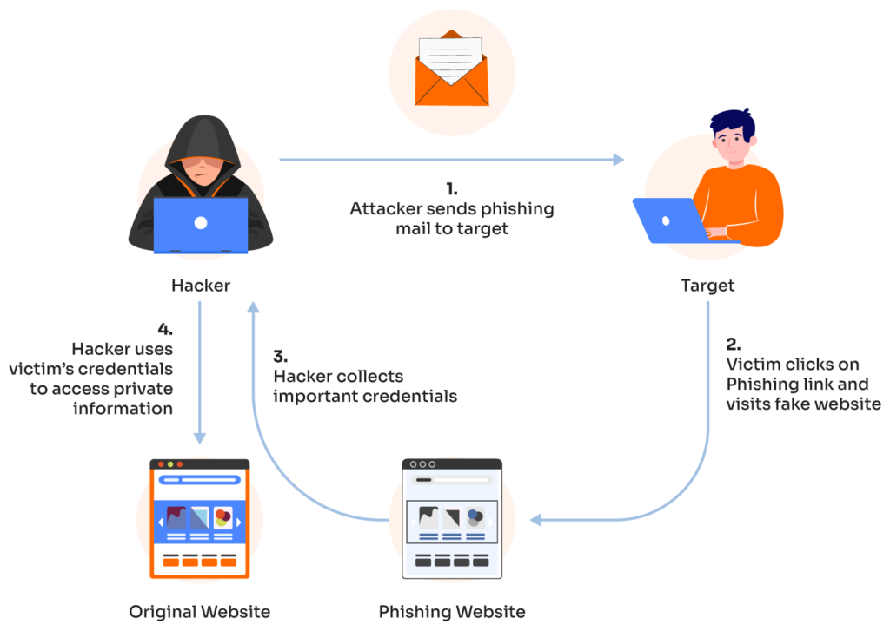
Pharming – Fake Webpages Continued

Slide 18
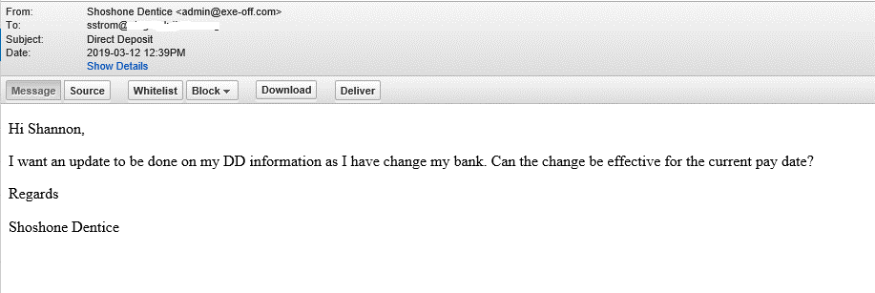
Spear Phishing
Spear Phishing: A more sophisticated phishing attack that appears to come from inside your organization or as a real trusted source.

Slide 19
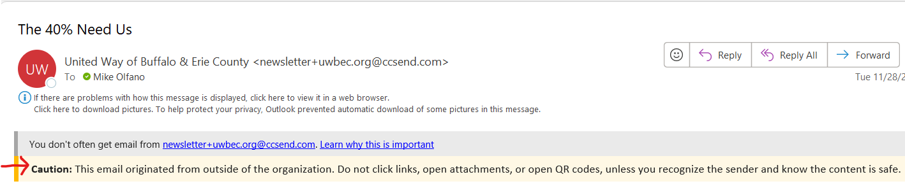
External Email Notifications
This can be easily enabled in Microsoft 365’s settings and it is free

Slide 20

Whaling
Whaling: A type of phishing attack that targets senior-level or high-risk personnel. To protect against whaling, quickly call the sender to confirm the message’s validity.

Slide 21
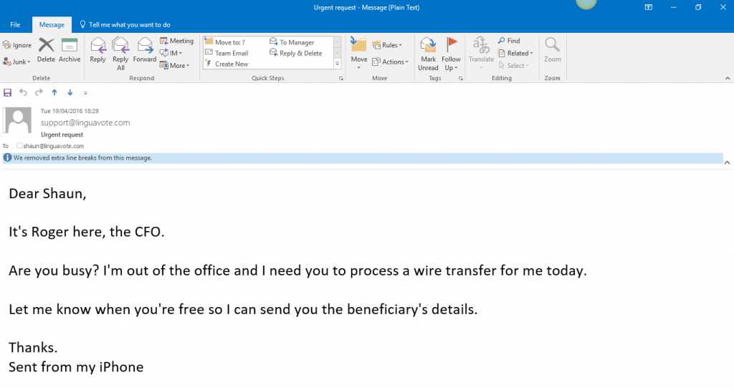
Whaling - Continued

Slide 22
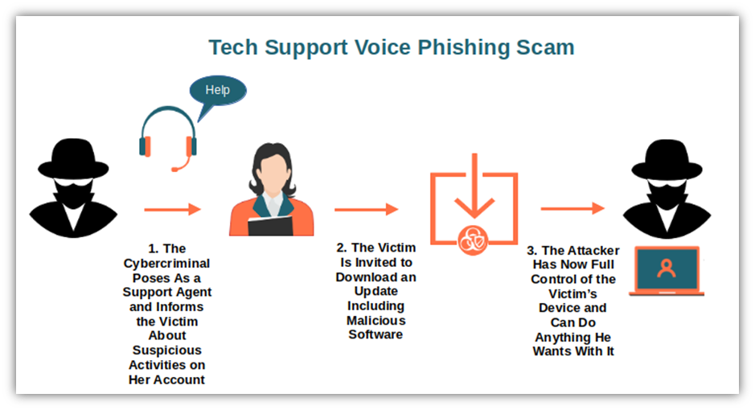
Vishing
A “trustworthy entity” under the guise of providing support to your users, is able to gather sensitive information or gain access to a user’s work machine

Slide 23
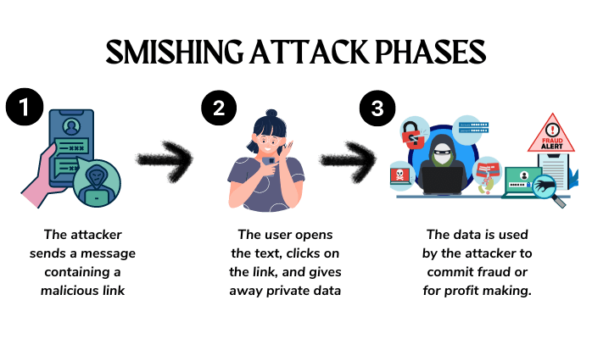
Smishing

Slide 24
Web Surfing
Keep website surfing limited to business use
Stay away from social media on work computers
Keep your browsers updated!
Be suspicious of pop-ups and download links!
Ctrl-W or Alt-F4

Slide 25
Polling Question #2
Do you have an incident response plan or disaster recovery plan?
Yes
No

Slide 26
Cybersecurity Horror Stories
Google and Facebook fell victim to imposter emails to the tune of $100M (BEC)
NFP funding sources (BEC)
NotPetya virus started as a phishing exploit then utilized an accounting software to deliver the payload. Losses estimated at $10B
Direct Deposit change requests
MGM and Caesar’s ransomware – Vishing attack with losses of $100M plus

Slide 27
Phishing/Spear Phishing/Whaling – Best Practices
User awareness training – using a platform like KnowBe4 or classroom style
Enable & enforce multi-factor authentication (MFA) on your email tenant (M365 or GSuite). Remember the statistic? 80% of BEC victims did NOT have MFA in place
Turn on your external email notification banner. This alerts you when an email comes from outside your organization
Avoid clicking on links in emails

Slide 28
Phishing/Spear Phishing/Whaling – Best Practices (cont)
Avoid opening attachments in email unless you are sure it’s coming from a known sender
Bank account changes should never be handled solely via email
Avoid accessing personal email on your business machine
Keep web surfing limited to business use on your work computer
Keep your computers and servers patched (Microsoft)

Slide 29
Polling Question #3
Does your organization have a password policy that is understood by all and enforced?
Yes
No
Not Sure

Slide 30
Recommended Cybersecurity Solutions
The must have solutions
Advanced solutions to consider

Slide 31
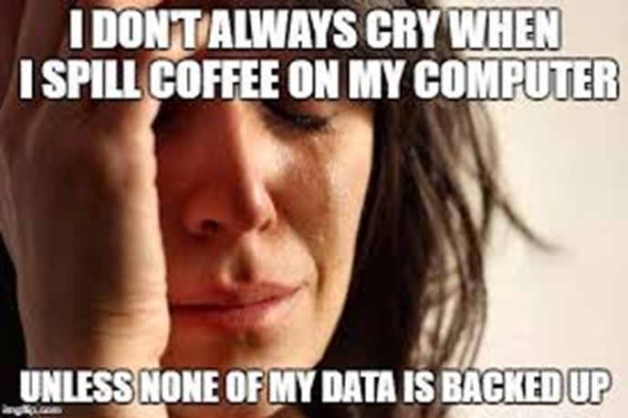
Must have #1
Backup and Disaster Recovery (BDR)
This is probably the most important piece of your cybersecurity defense
Secure onsite backups
Secure offsite (cloud) backups
Disaster recovery capabilities

Slide 32

Must have #2
Firewall
Establishes a barrier between secured and controlled internal networks and untrusted external networks, such as the Internet (protects the perimeter of your network)
Monitors incoming and outgoing traffic
Decides whether to allow or block traffic based on a defined set of security rules
Can be hardware, software or both

Slide 33
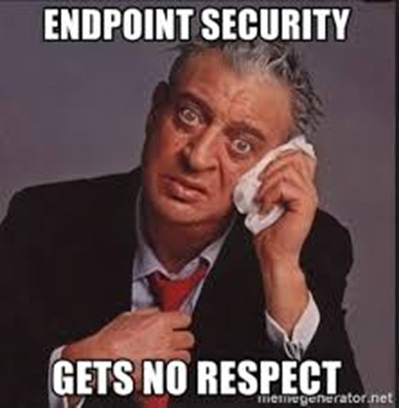
Must have #3
Endpoint Protection (the more advanced, the better)
Antivirus
Anti-malware
Anti-spam / spam filtering
URL/DNS filtering
Encryption

Slide 34

Must have #4
User Awareness Education and Ongoing User Testing
Education on best practices and cybersecurity-related do’s and don’ts
Helps every employee in your organization recognize, avoid and report potential threats
Email phishing tests

Slide 35
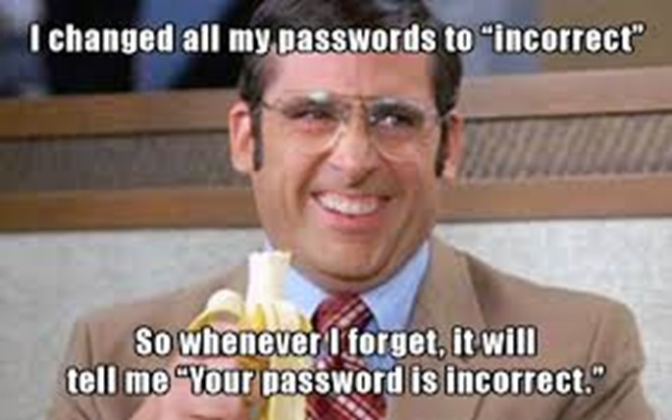
Must have #5
Password Policy
Minimum length (12 to 14)
Complex (contains upper & lower case, numbers and symbols)
Unique
Securely stored
A 14 character complex password currently takes ~ 1M years to crack
Password change frequency (a controversial subject). The industry standard is quarterly
Password will eventually be replaced with new technology

Slide 36
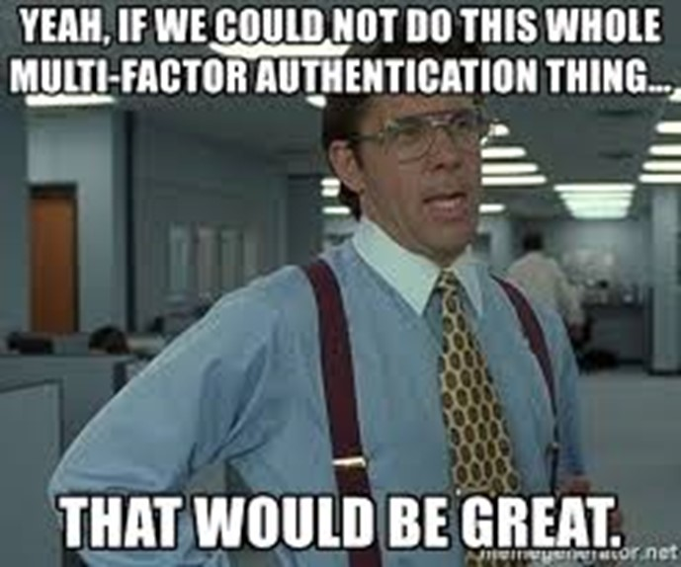
Must have #6
Multi-Factor Authentication (MFA)
Security methodology that verifies a user’s identity by requiring multiple credentials
Text message, smartphone app, USB or other physical device
Implement MFA whenever possible
M365 MFA is an absolute must

Slide 37
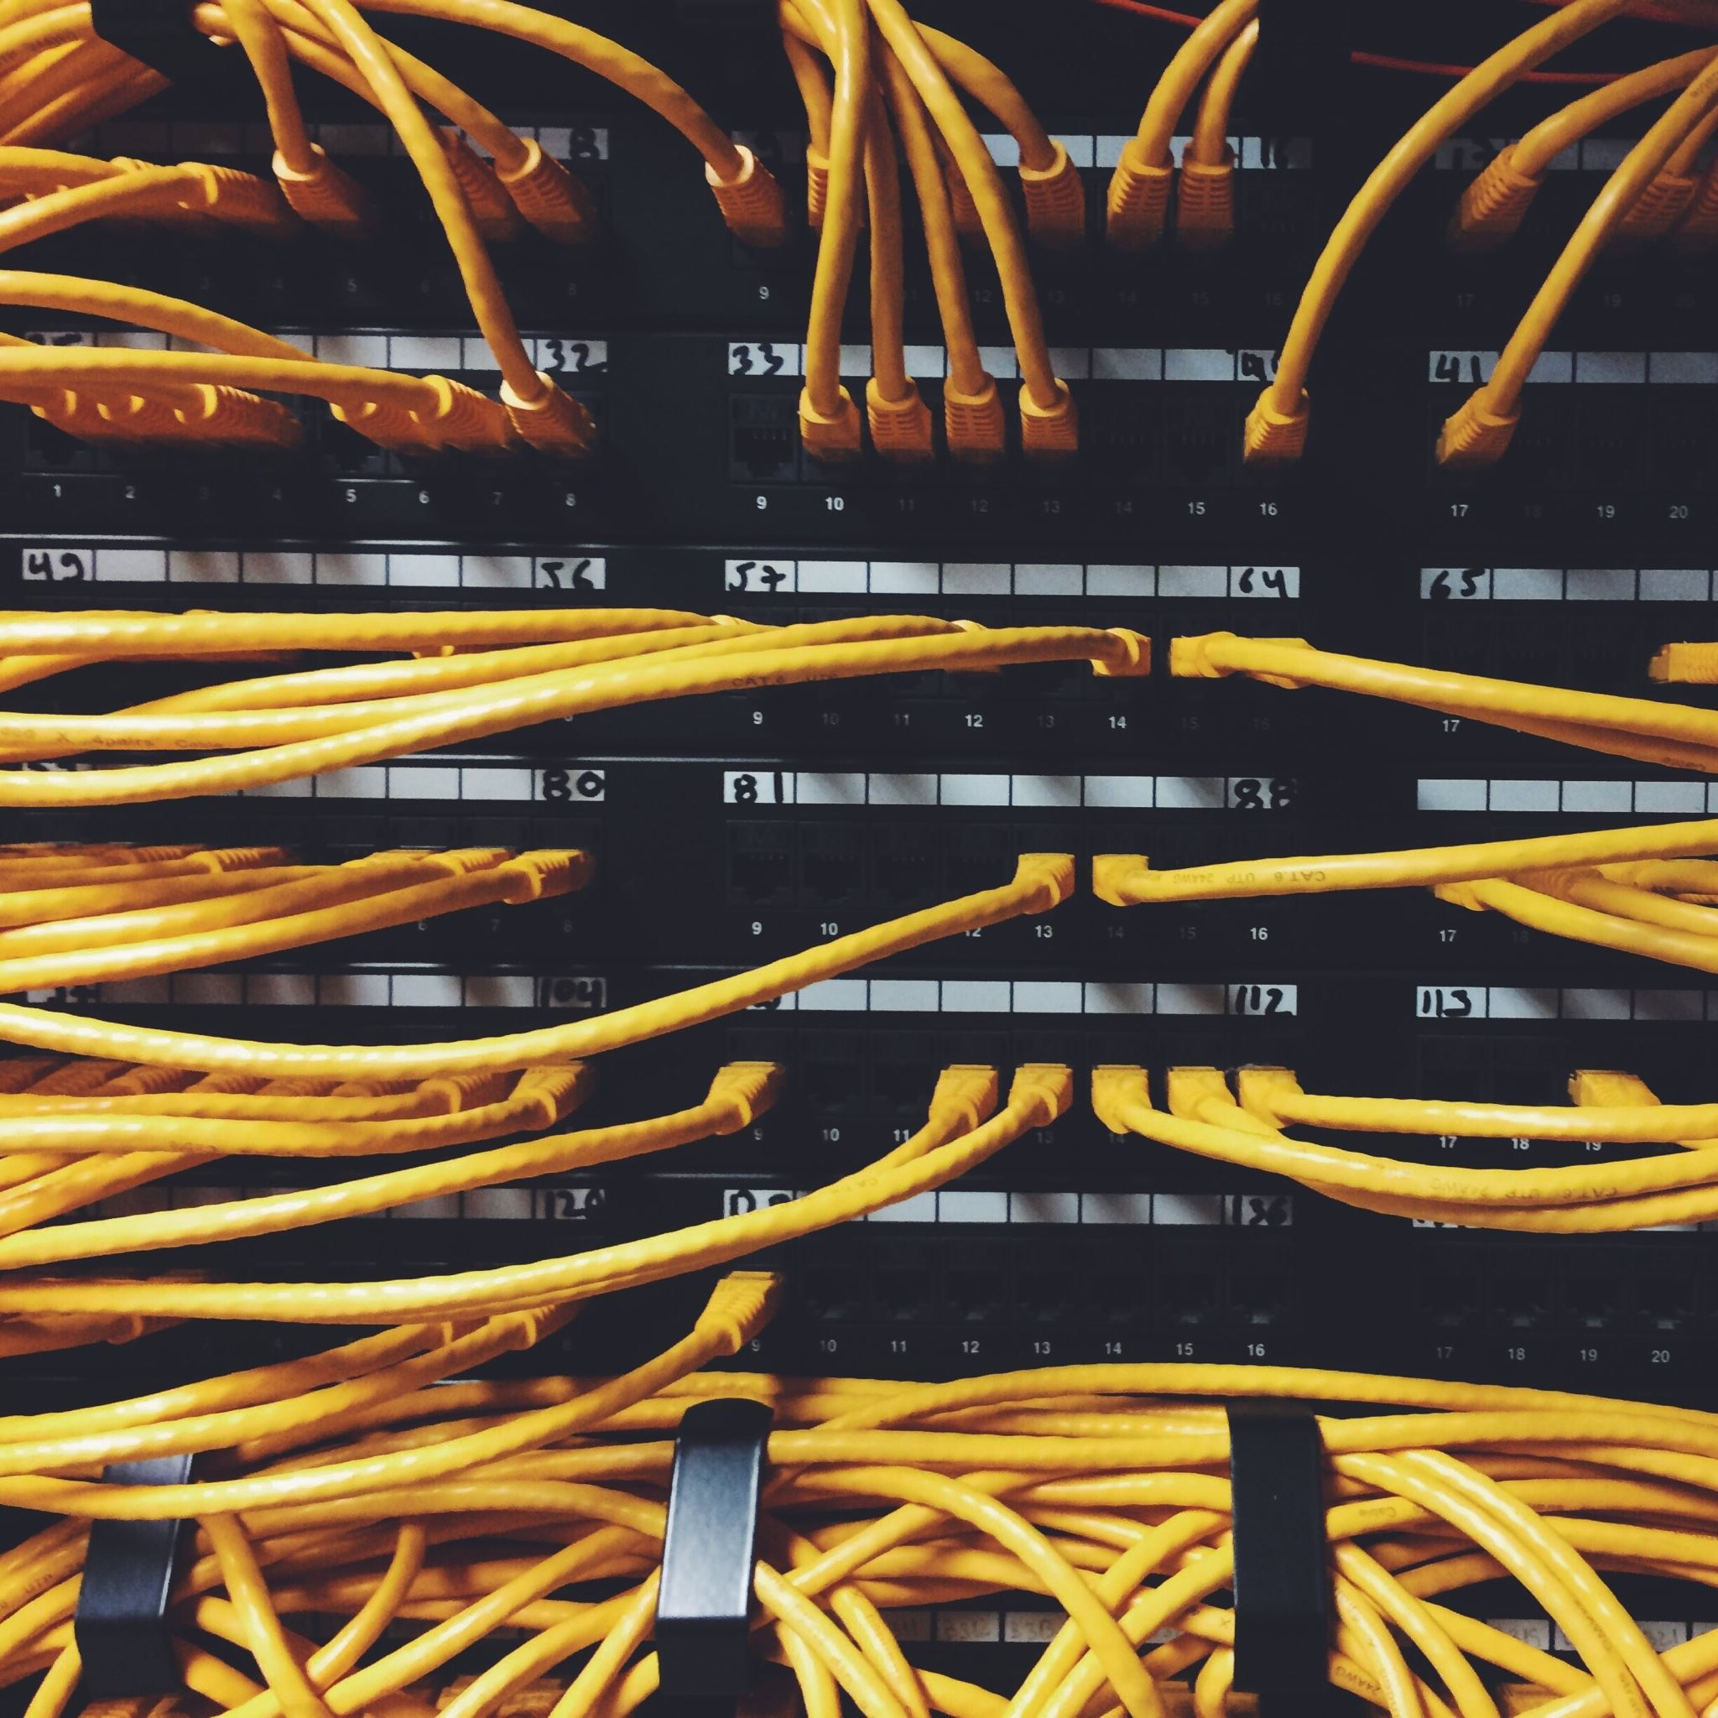
Must have #7
Patching of key hardware / software
Microsoft patching on workstations and servers
Security updates / patches on firewalls, switches, and access points
Browser updates
Updates for critical software

Slide 38
Polling Question #4
What is called when a “trustworthy entity” asks (typically via email) for your sensitive information such as SSN, credit card numbers, login or password information, etc.?
Flailing
Trolling
Phishing

Slide 39
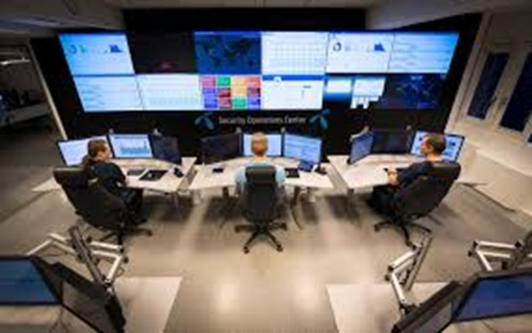
Advanced Solutions #1
Security Operations Center (SOC)
Information security team that monitors and analyzes an organization’s security posture on a 24x7x365 basis
Includes an incident response team that ensures that security issues are addressed quickly upon discovery
Uses a combination of dynamic technology solutions and a strong set of processes
There are vendors that offer this as a service

Slide 40
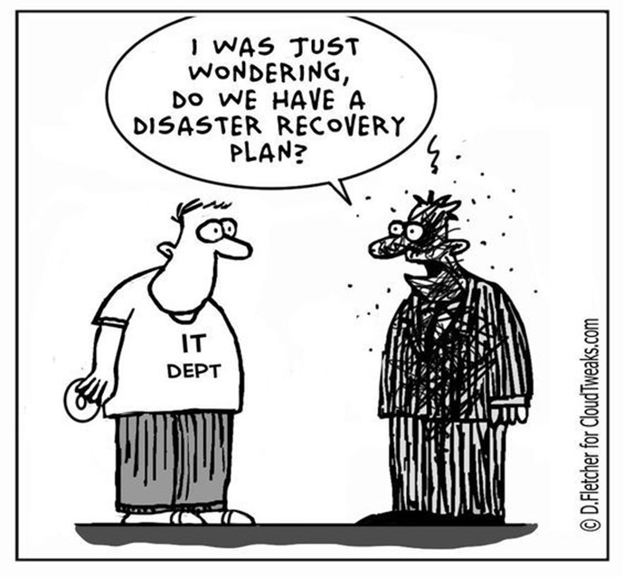
Advanced Solutions #2
Scanning, Testing and Documentation
Internal vulnerability scans operate inside your firewalls to identify real and potential vulnerabilities inside your business network
External vulnerability scans look for holes in your network firewalls
Penetration testing
Documentation on items such as governance, risk, compliance and privacy
Key policies: Incidence Response Plan, Disaster Recovery Plan - IMPORTANT

Slide 41
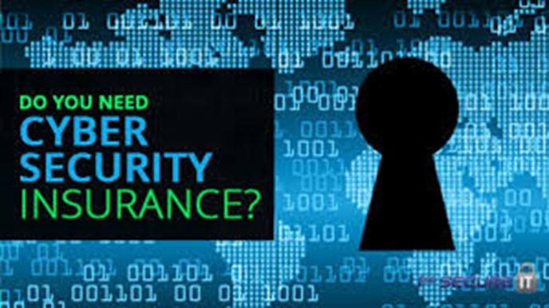
Advanced Solutions #3
Cyber Insurance
Protection against damages resulting from electronic threats to your computer systems or data
Cyber insurance and E&O (Error & Omissions) insurance policies should be with the same carrier

Slide 42
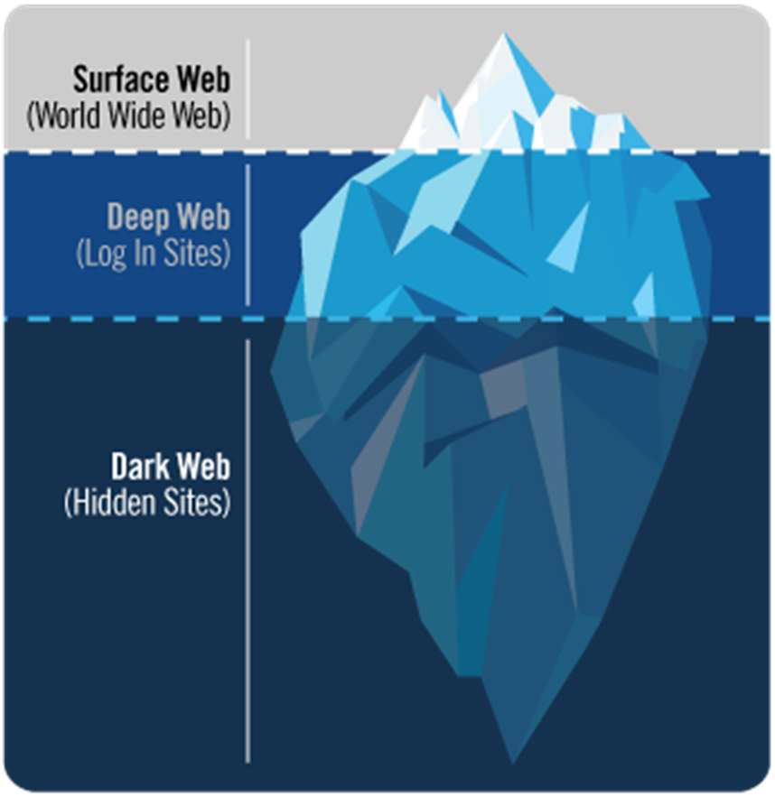
Advanced Solutions #4
Dark Web Monitoring
The Dark Web is a hidden universe within the Deep Web, a sub-layer of the Internet
The Dark Web is estimated to be 550 times larger than the Surface Web, and growing
Scours botnets, criminal chat rooms, blogs, websites, bulletin boards, forums, private networks, and other black-market sites for stolen credentials and information

Slide 43
Polling Question #5
Was this presentation informative?
Yes
No
Maybe

Slide 44

Sources
The Gartner Group
Splunk.com
Astra
CompTIA
Microsoft
PCA Technology Group, Inc.
molfano@pcatg.com
716.632.5881 x314

Slide 45

Thank you
Mike Olfano, CEO
PCA Technology Group, Inc.
molfano@pcatg.com
716.632.5881 x314

